Slide 1
AP STATS: Warm-Up

Slide 2
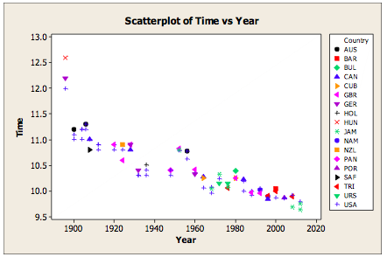
Regression from Yesterday

Slide 3
Video of the Day

Slide 4
Some Important Ideas from the reading you did.
Regression Line: A line that describes how a response variable y changes as an explanatory variable x changes. (regressions are “models” of the data – much like a density curve).
y = a + bx where b is the slope and a is the y-intercept.
The slope represents the amount that y changes (the response variable) when x (the explanatory variable) increases by one unit.
Most importantly, the regression line can be used to predict a specific y-value for a specific value of the explanatory variable x.
EXTRAPOLATION: the use of a regression line to predict values outside the range of values of the explanatory variable x used to obtain the line (like predicting the 100 meter time in 2020).
INTERPOLATION: is predicting a value INSIDE the range of values of the explanatory variable.

Slide 5
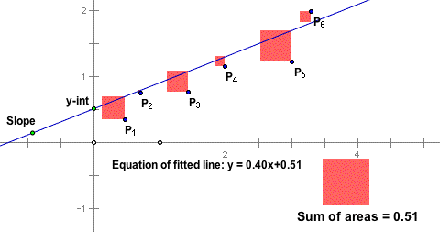
The Least Squares Regression
A line that makes the sum of the squared vertical distances of the data points from the line as small as possible.
RESIDUALS (Prediction Error): the distance of each data point from the LSRL.
In the 1950s and 1960s, economists used electromechanical desk calculators to calculate regressions. Before 1970, it sometimes took up to 24 hours to receive the result from one regression.

Slide 6
We use y-hat because it the predicted value.

Slide 9
Stat Software Output

Slide 10
BRAINSTORM FOR YOUR 2nd PROJECT
Your project for chapter 3 will be similar to your last project. Collect some quantitative data to make a scatter plot and fit a regression (more detailed directions to come). It will be due in 2 weeks.
Brainstorm what you might like to find a correlation between. Generate a bunch of ideas and then start to narrow it down.
You may collect your own data or find data already online.
You may work individually, or in groups of 2-3.

Slide 11
HW #21
Read Pg. 205-211 in section 3.2
#3.33, 3.35

