Slide 1
Honors Precalculus: Do Now
Check these HW Problems from the weekend with a partner.

Slide 2
Video of the Day…
Reminders:
Unit Test on Friday, April 11th-
Chapter 5 plus a question from Ch. 6
(law of sines or cosines)

Slide 3
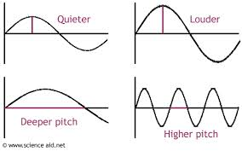
Modeling Periodic Behavior
Examples of periodic behavior
Sound waves

Slide 4
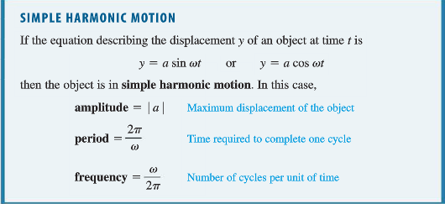
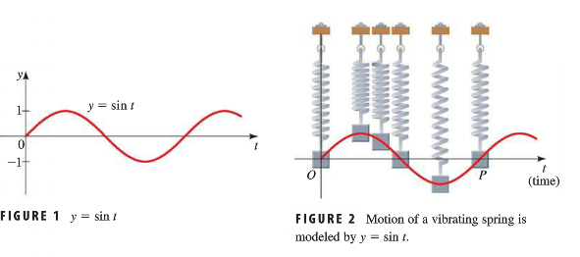
Modeling Simple Harmonic Motion

Slide 5
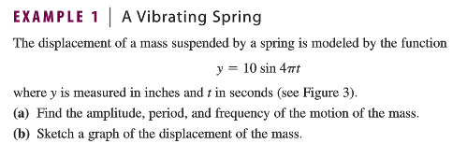
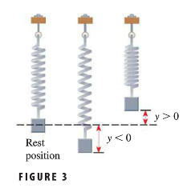

Slide 6
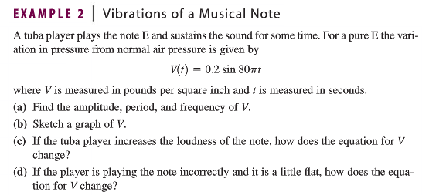
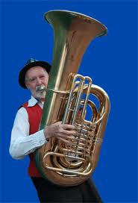

Slide 8
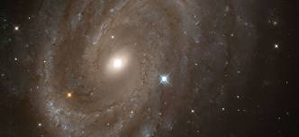
Example 4: Star Brightness $$y=\operatorname{asin}\left(ω\left(t−c\right)\right)+b$$

Slide 9
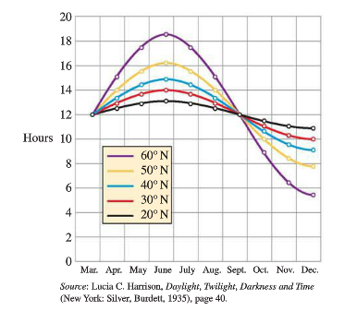

Slide 10
HW #19: Modeling Harmonic Motion
Section 5.6 Page 451 #3, 11, 28, 29, 31, 35

