Slide 1
Take the anonymous survey on your desk.
Answer questions in order.
Do not change answers to previously answered questions.
Question 6 is on the back.
When you are done, take your index card and neatly write a survey question that you could ask Moses Brown students about of your choosing.

Slide 2
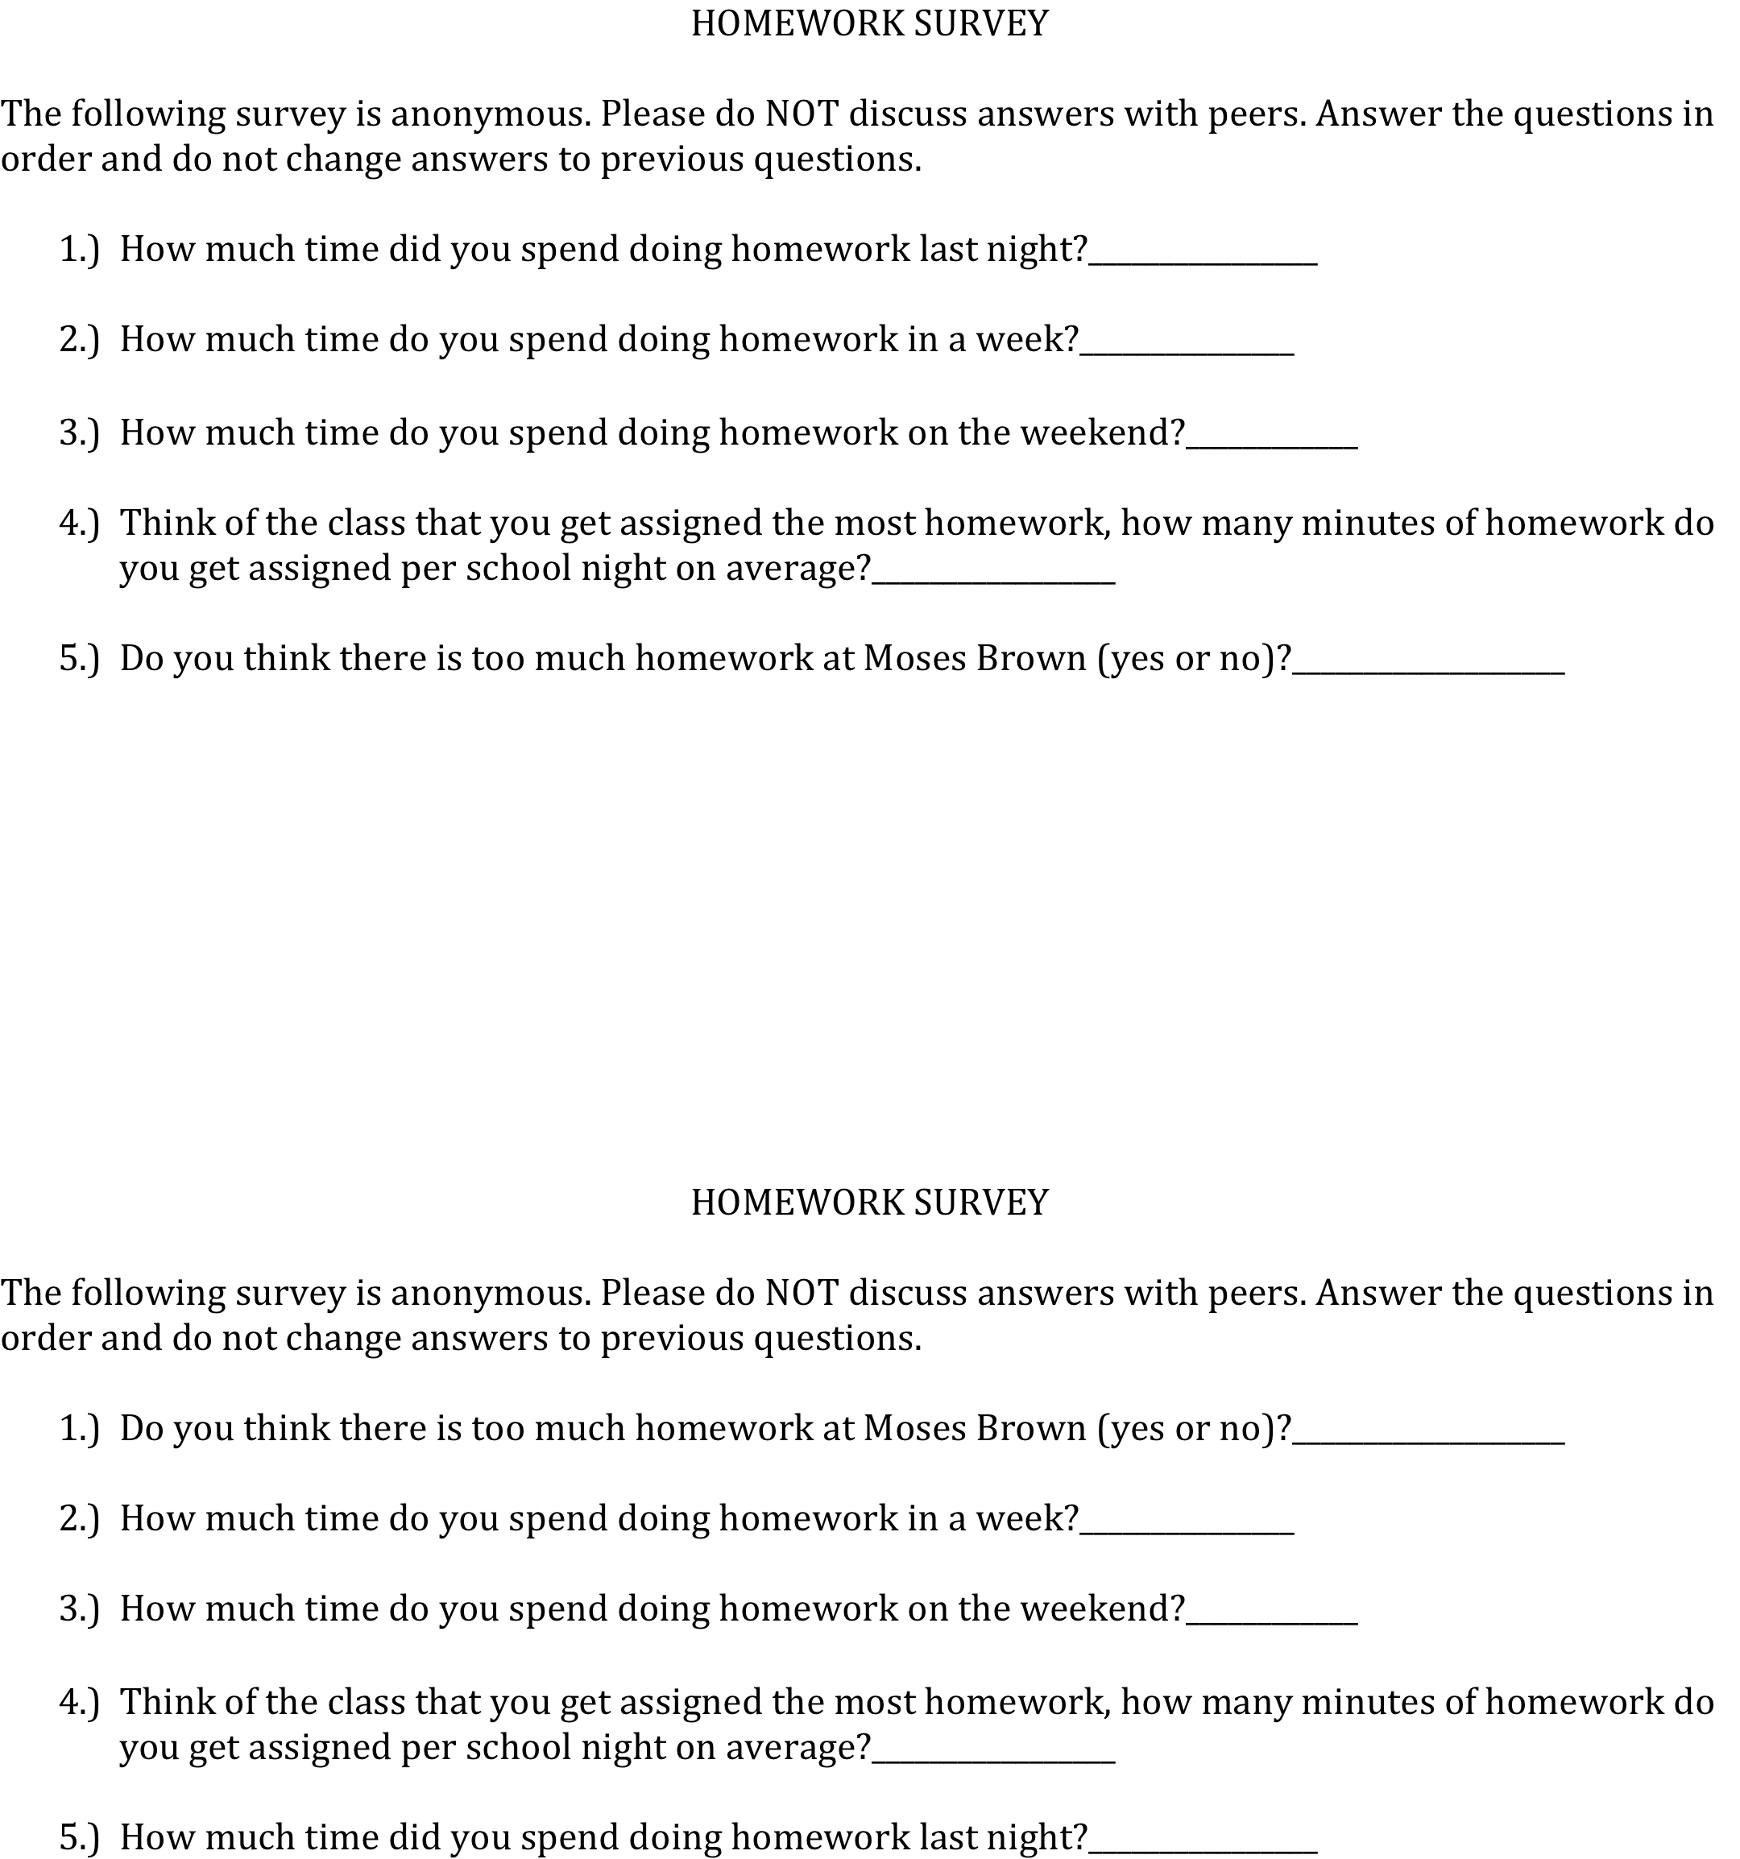
Does wording and order matter?

Slide 3
Does wording matter?
6.) Do you watch cartoons (yes or no)?____________________ (90%)
6.) Do you still watch cartoons (yes or no)?____________________ (60%)
Design a question that is made to create a bias in responses.
Now redesign the question to be less biased.

Slide 4
Questions to ask before you believe a poll… BE SKEPTICAL! Insist on Answers.
Who carried out the survey?
What was the population?
How was the sample selected?
How large was the sample?
What was the response rate?
How were the subject contacted? Phone/email
When was the survey conducted (i.e. time of day/season)

Slide 5
Systematic Sampling
Sample every nth person. This is oftentimes used in exit polls.
Can be risky though…

Slide 6
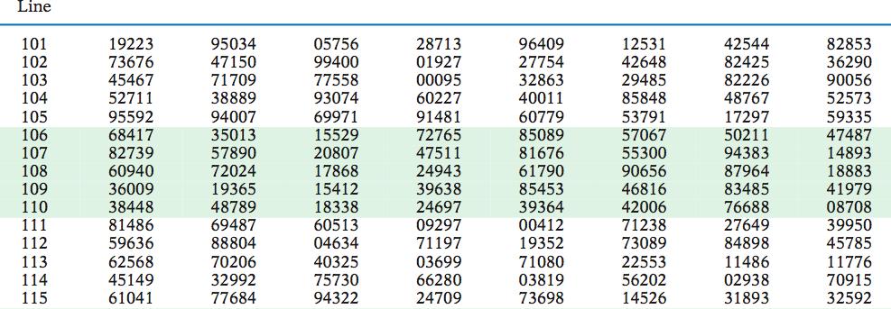
Using Table B
Label: 001, 002, …200

Slide 7
Biases in Surveys
Even with random selection from the population, we can still run into various biases:
Undercoverage: Some groups of the population might be left out.
Accurate and complete list of the population might be missing (might be missing prisoners, homeless, those without a residential phone, etc.)
Nonresponse: occurs when an individual chosen for the sample can’t be contacted or does not cooperate.
Even with careful planning and multiple callbacks this often reaches 30% or more.
Most sample survey and opinion polls are done over the phone. This can create a HUGE non-response bias.

Slide 8
Response Bias
The behavior of the respondents or of the interviewer can cause response bias:
Respondents might lie about illegal or unpopular behavior.
The race or gender of the interviewer might influence responses.
Wording of questions – can oftentimes influence responses. Confusing questions and leading questions can influence responses.

Slide 9
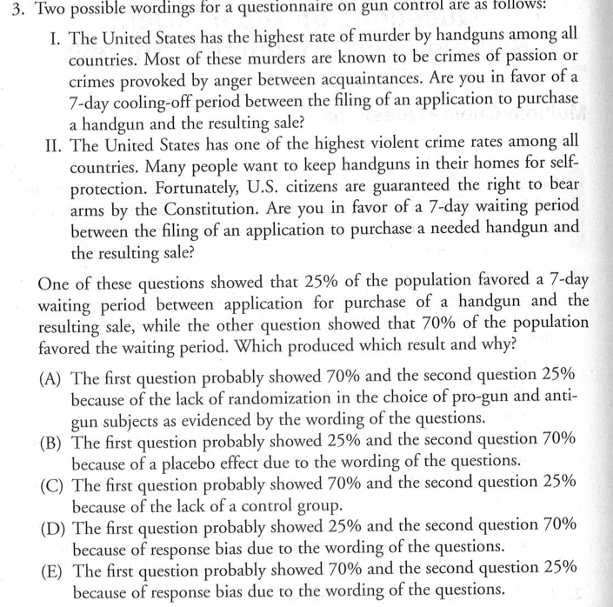

Slide 10
Why we take samples?
We take samples to make inferences about the population.
Different samples will undoubtedly produce different results.
LARGE SAMPLES help get around this as they eliminate error (but this only works if the sample is taken at random). Large samples that are biased aren’t useful (i.e. voluntary “samples”)

Slide 11
Next week we will discuss the details of experiments!
In an observational study: we observe individuals and measure variables of interest BUT DO NOT ATTEMPT TO INFLUENCE THE RESPONSES.
Difficult to determine cause and effect because of confounding variables
EXPERIMENT: WE DELIBIRATELY IMPOSE SOME TREATMENT ON INDIVIDUALS IN ORDER TO OBSERVE THEIR RESPONSES. (treatment and control groups/ Double blinding). Need to be able to replicate and generalize (holds true in a # of settings)

Slide 12
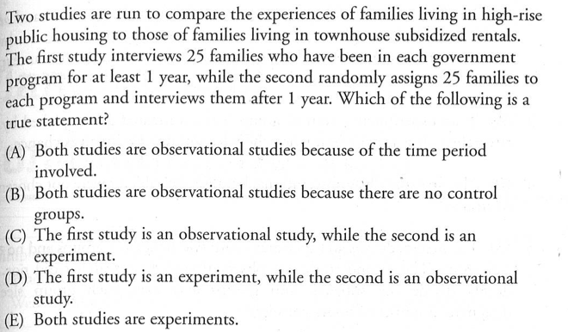

Slide 13
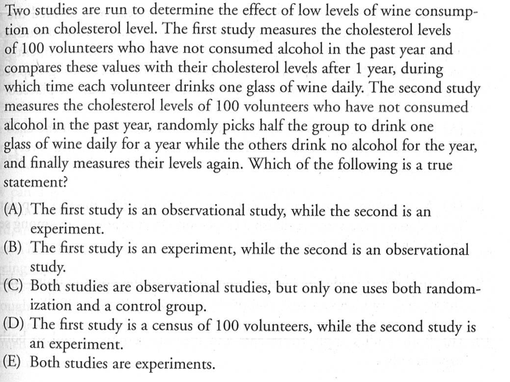

Slide 14
Homework
Read the AP Book For topic 6 and 7
Complete Multiple Choice Questions for Topic 6 and 7
http://www.huffingtonpost.com/news/pollster/
Read How are polls conducted: Gallup
Shorter:
http://www.gallup.com/poll/101872/how-does-gallup-polling-work.aspx
http://www.washingtonpost.com/wp-dyn/articles/A22188-2005Jan19.html

