Slide 1
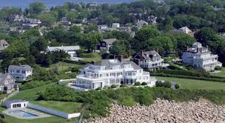
Honors Precalculus: Do Now
A flood insurance company in Watch Hill charges different rates to its policy holders depending on the location of their home. The company places policyholders in 3 different groups depending on whether one’s home is located on the Ocean, Bay, or in town. Oceanfront houses make up 28% of the company’s policy holders, Bay-front houses make up 33% of the company’s policy holders and 39% of covered homes are located in town. On average, 17% of policy holders who file a claim have an oceanfront home, 4% of policy holders who file a claim have houses on the Bay and 1% of policy holders file a claim live in town.
What percent of the company's policyholders are expected to have a claim during the next year?
(b) Suppose a person has just had filed an insurance claim. If he/she is one of the policyholders, calculate the probability that he/she has an oceanfront house.
C.) Which group would you suspect has the highest premiums?

Slide 2
Weekly Agenda
Today: Bayesian Probability
Thursday: More probability/Review for the Quiz
Tuesday: Quiz on Bayesian Probability and Discrete Probability!
SHOUT OUTS TO….
Lily Z, Kara H, and Amelia G!!

Slide 3
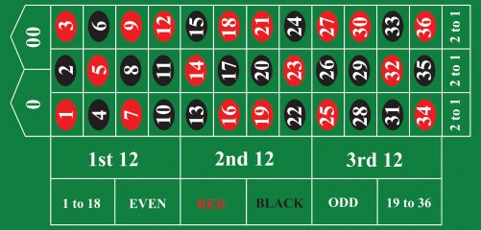

Slide 4
More Fun Facts on Probability: FRAMING
The homework tonight will also have a reading assignment from a book that I read this summer by the Nobel Prize winner in economics Daniel Kahneman (who is a psychologist by training).
The book it is from is called “Thinking, Fast and Slow”.

Slide 5
2 Options:
600 people are diagnosed with a deadly disease and need treatment
Treatment A: Saves 200 people's lives
Treatment B: A 33% chance of saving all 600 people, 66% possibility of saving no one.

Slide 6
2 Options:
600 people are diagnosed with a deadly disease and need treatment
Treatment A: 400 people will die.
Treatment B: A 33% chance of saving all 600 people, 66% possibility of saving no one.

Slide 7
Key Intuitions from Studies
Treatment A was chosen by 72% of participants when it was presented with positive framing ("saves 200 lives") dropping to only 22% when the same choice was presented with negative framing ("400 people will die").
Prospect Theory: A Loss are more significant than an equivalent gain. Also that a sure gain is favored over a probabilistic gain.
93% of PhD students registered early when a penalty fee for late registration was emphasized, with only 67% doing so when this was presented as a discount for earlier registration.
75% lean meat as opposed to 25% fat.
95% effective versus 5% failure rate.

Slide 8
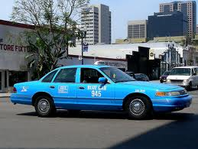
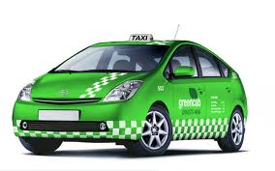
Example 1: EYE WITNESS
A cab was involved in a hit and run accident at night. Two cab companies, the Green and Blue, operate in the city. It is known that 85% of the cabs in the city are Green and 15% are Blue. A witness identified the cab as blue. The court tested the reliability of the witness under the circumstances that existed on the night of the accident and concluded that the witness correctly identified each one of the two colors 80% of the time and failed 20% of the time.
What is the probability that the cab involved in the accident was blue given that the witness identified the cab as being blue?

Slide 9
Example 2: SPAM
Suppose that a Bayesian spam filter is trained on a set of 10,000 spam messages and 5,000 non- spam messages. The word “enhancement” appears in 1500 spam messages, and 15 messages that are not spam. The word “herbal” appears in 800 spam messages, and 200 messages that are not spam. Would an incoming message using Bayesian probability estimates be classified as spam if it contains the word “enhancement”? Assume the threshold for accepting is 0.90?
What if it contained the word “herbal”? Assume the threshold for accepting is 0.90?

Slide 10
Example 3: INSURANCE
An insurance company finds that the probability that a homeowner has a claim in any given year is 0.0725. They find that the homeowners likely to have repeated claims make up about 15% of their policy holders and have a rate of 0.2 claims per year. Calculate the probability that a homeowner will have repeated claims if there is a claim in the homeowner's first year with the company.

Slide 11
Problem Set: In Teams
Work in Groups of 2-3 to complete the problem set on Bayesian Statistics.
Whatever you don’t finish will be homework.

