Slide 1
Conic Sections: The Circle
Alfie Parr

Slide 2
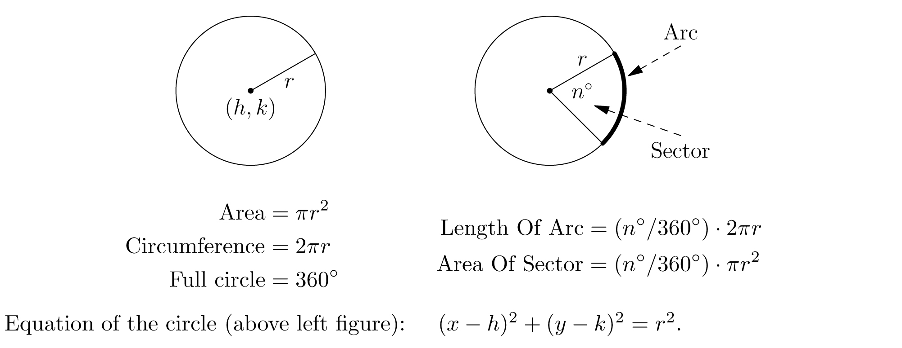
What the heck is a circle?!
This:
(seems
familiar…)
Note that all pts
on a circle are
a fixed distance
from the center!
https://benchprep.com/blog/wp-content/uploads/2012/03/circle-formulas1.jpg

Slide 3
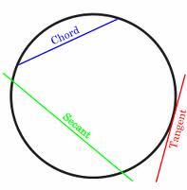
What else do we know about circles?
full arc= 360º= 2π radians
they’re really cool
occur in nature
smallest perimeter for a given area
they’re symmetrical
math.info
http://www.kidsmathgamesonline.com/facts/geometry/circles.html

Slide 4
It’s also a conic section!
http://www.drcruzan.com/MathConicSectionss.html

Slide 5
Equation of a circle
(x - h)² + (y - k)² = r²
In the abv equation, r is the radius of the circle
h and k represent the center (h, k)
A circle centered at the origin will have the equation
x² + y² = r²
A circle at the origin and with a radius of one will have the equation
x² + y² = 1

Slide 6
Equation of a circle (cont)
For ease of comparison to other conic sections, the equation of a circle is sometimes set to one:
(x - h)² + (y - k)² =1
r² r²
This equation is for a circle with radius r and center (h, k)
Each point (x, y) is still related to r by the Pythagorean theorum

Slide 7
Visual example of this cool circle situation:
Here, C = d, which is equal to 2r
A more relevant depiction of the relationship between the radius (c) and the x (b) and y (a) components of each point (bottom)
http://www.rfcafe.com/miscellany/smorgasbord/images/draw-circle-with-square.jpg

Slide 8
Graphing the circle
The center is at (h, k)
The eccentricity of the circle is zero
The circle is a special ellipse
c/a will always equal zero because the center and what could be considered to be the focus of a circle are at the same location
Using the radius and center, all points can be calculated by means of the Pythagorean theorem

Slide 9
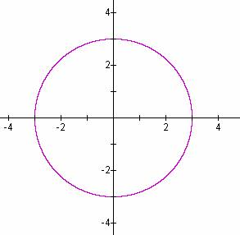
Graphing the circle (cont)
For example, graphing x² + y² = 9 is very simple
h and k are both zero, so the center is at the origin
r² = 9, sqrt both sides, the radius is 3
All points are 3 units from the center
http://jwilson.coe.uga.edu/EMAT6680/Cooper/asn2tc/asn2_files/image007.jpg

Slide 10
Graphing the circle (cont)
What about graphing (x + 1)² + (y - 3)² = 4?
Comparing it to the initial equation ((x - h)² + (y - k)² = r²) makes the task much easier
The center, (h, k), is (-1, 3)
The radius is two, because 4 can be set to r²
It’s a simple variation on the circle we already graphed!

Slide 11
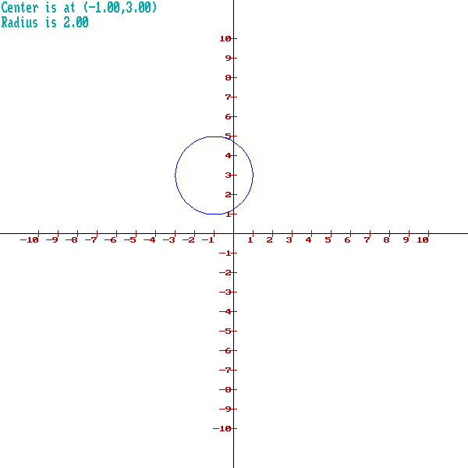
. center (-1, 3)
Made with webmath.com’s circle graph maker

Slide 12
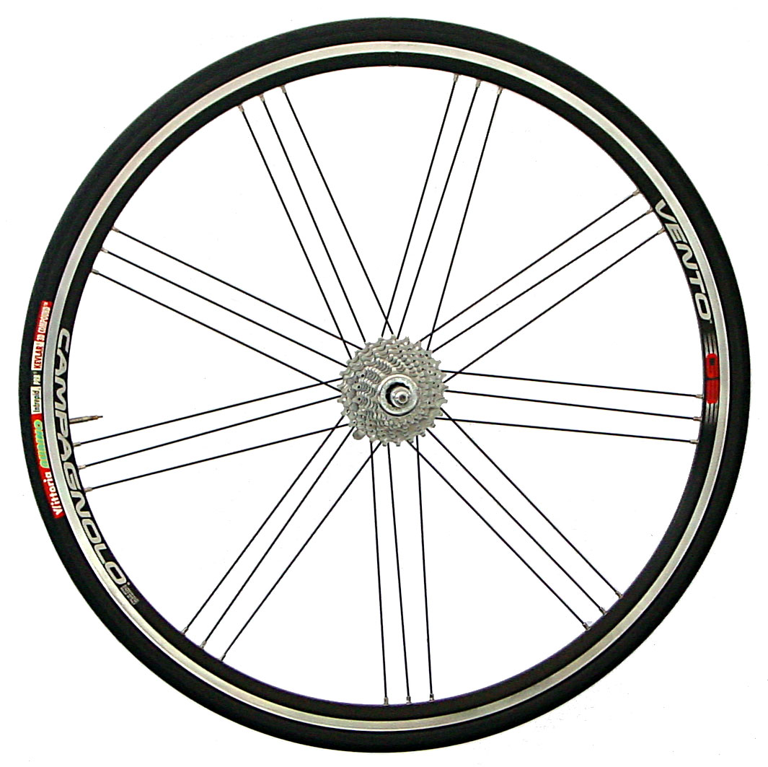
Real-life application of the circle:
The wheel!
(an exceedingly useful
invention in the shape
of a circle)
http://upload.wikimedia.org/wikipedia/commons/9/96/Laufrad-campa-vento.jpg

Slide 13
Have a rad day!

