Slide 1
Honors Precalculus: Do Now
Find the rectangular coordinates that correspond with the given polar coordinates.
(12, )
Convert the equation to polar coordinates.
x + y = 4
Convert the polar equation to rectangular coordinates.
r = 6 sin θ
The test average was an 86.66 with the extra credit included.

Slide 2
Images of the Day
http://www.boredpanda.com/amazing-places/?fb_action_ids=611356110332&fb_action_types=og.likes&fb_source=other_multiline&action_object_map=%7B%22611356110332%22%3A365526640220626%7D&action_type_map=%7B%22611356110332%22%3A%22og.likes%22%7D&action_ref_map=%5B%5D
Quiz on 8.1-8.2 on Thursday. Review the day before.

Slide 3
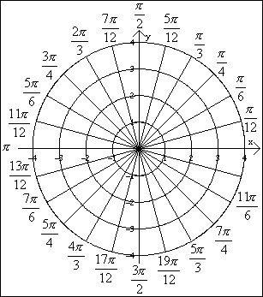
Example 1: Sketching a Polar Equation
Sketch the graph r = 3

Slide 4
Example 2: Sketching a polar equation
Sketch θ = π/3

Slide 5
Example 3: Another Sketch
Sketch a graph of the equation r = 2 sin θ

Slide 6
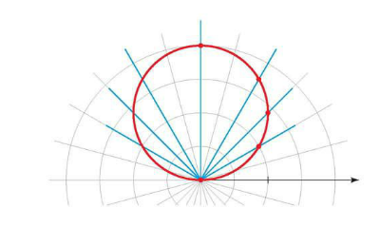

Slide 7
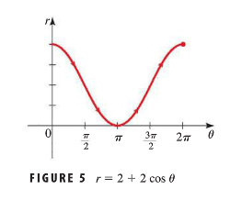

Slide 9
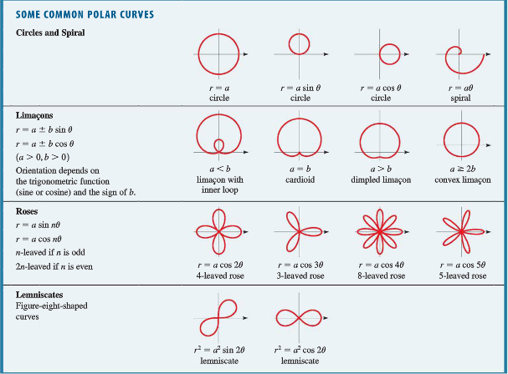
Graphing on a Calculator
Graph each of the following with a partner.
r = 2 + 2cos θ
r = cos 2θ
r=2sin(4θ)
r = 1 + 2θ
r =cos(2θ/3)
r = sin θ + sin³(5θ/2)
See the table on page 594 for the names of these shapes.

Slide 11
HW #28
Section 8.2 (pg. 553-554) #3-8, 17, 19, 21, 25, 29, 43, 44, 49-52, 53
Review tomorrow in class (quiz on 8.1-8.2 on Thursday).

