Slide 1
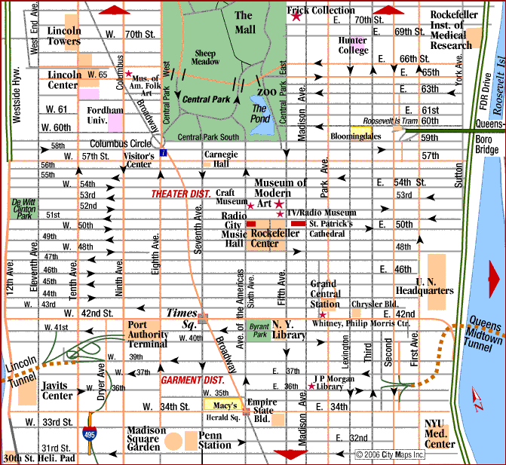
HPC: Warm Up You’ve just arrived in Manhattan by train. Penn Station (W 33rd and 7th Ave). Give directions of how to get to Rockefeller Center

Slide 2
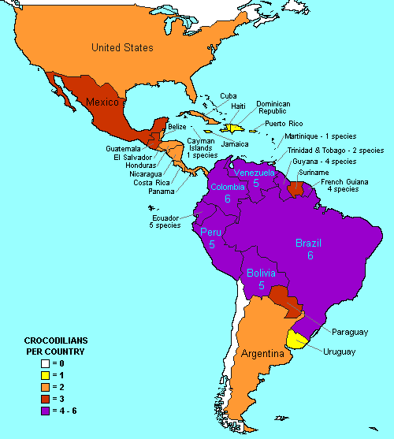

Slide 3
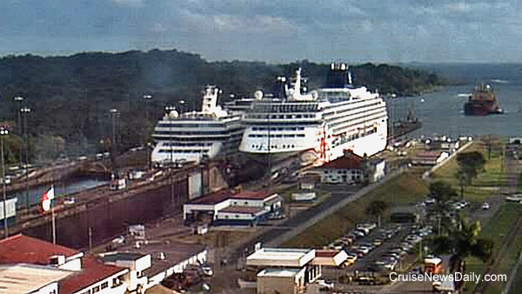
Fun Fact
How much was the toll for the Norwegian Pearl to pass through the
Panama Canal?

Slide 4
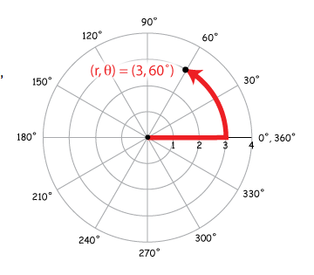
Cartesian Coordinates vs. Polar Coordinates
Polar coordinates, given by (r, θ) where r is the distance from the origin (the pole) and θ is the angle from the positive x-axis.

Slide 5
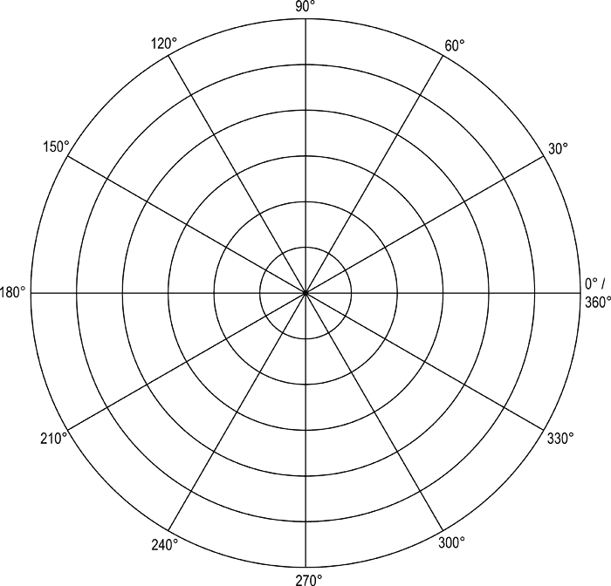
Example 1: Plotting Polar Coordinates
Plot the points whose polar coordinates are given.
(1, 3π/4) (3, -π/6) (3, 3π) (-4, π/4)

Slide 6
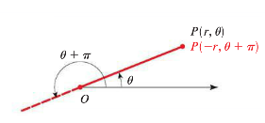
Representing the same points with different coordinates.

Slide 8
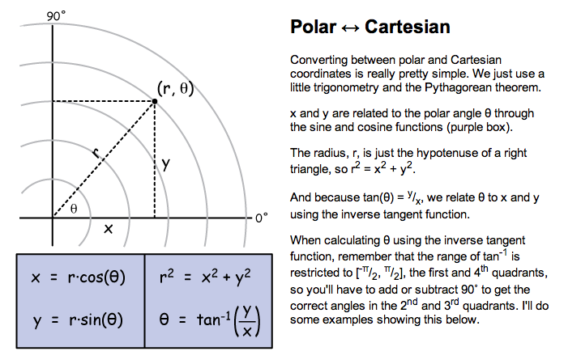
Going between the 2 coordinate systems

Slide 9
Example 1: Polar to Rectangular
Find the rectangular coordinates for the point that has polar coordinates (4, 2π/3).

Slide 10
Example 2: Rectangular to Polar
Find the polar coordinates for the point that has rectangular coordinates (2, -2).

Slide 11
You Try!
1.) Find the rectangular coordinates for the point that has polar coordinates (-4, 5π/2).
2.) Find the polar coordinates for the point that has rectangular coordinates (-7, 7).

Slide 12
Example 3: Polar Equations
Express the equation x² = 4y in polar coordinates.

Slide 13
Example 4: Converting equations from polar to rectangular coordinates.
a.) r = 5 sec θ b.) r = 2 sin θ c.) r = 2 + 2cos θ

Slide 14
You Try!
a.) r = 4 sin θ b.) r = 5 + 4cos θ

Slide 15
WHITEBOARDS

Slide 16
Homework #26
Section 8.1 (Pg. 546-547) #3, 5, 9, 27, 35, 37

