Slide 1
AP STATS: Also check your answers to the HW 34 – the “quiz” from last night.

Slide 2
Video of the Day
http://www.youtube.com/watch?v=itaMNuWLzJo
How a random number generator works…
123 rand
Truly random – atmospheric noise

Slide 3
Reminders:
For Monday – Complete your project (does not need to be very long– just precise) and study for a very brief quiz on section 6.2 – Open Notes/Textbook Read section 6.2.

Slide 4
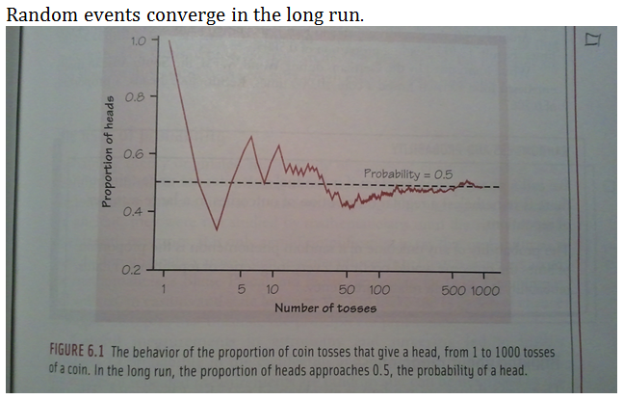
Randomness and Probability
Outcomes that seem random in the short run will converge to a predictable outcome in the long run. Examples: tossing coins, drawing cards, selecting balls in a bag.
Probability can simply be thought of as long term relative frequency.
Trials must be
Independent.
The Gambler’s Fallacy
“Flip a quarter” 5 times on your calculator.
0=heads and 1 = tails

Slide 5
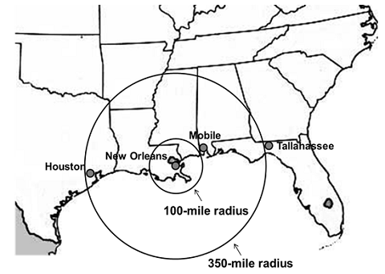
The Signal and the Noise Example
The field of probability is surprisingly relatively new in mathematics. First studied in the field of gamblung games in the sixteenth and seventeenth centuries
Predicting the weather… models.
[If] prediction is the truest way to put our information to the test, we have not scored well. In November 2007, economists in the Survey of Professional Forecasters — examining some 45,000 economic-data series — foresaw less than a 1-in-500 chance of an economic meltdown as severe as the one that would begin one month later. Attempts to predict earthquakes have continued to envisage disasters that never happened and failed to prepare us for those, like the 2011 disaster in Japan, that did.
The discipline of meteorology is an exception. Weather forecasts are much better than they were 10 or 20 years ago.

Slide 6
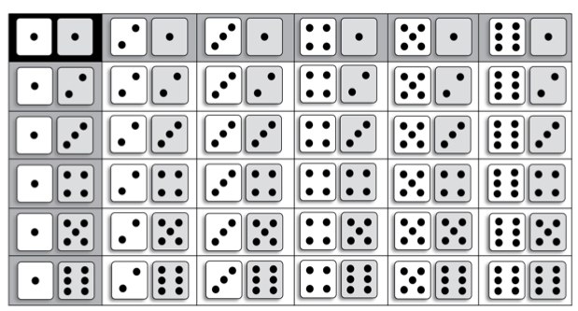
Probability When Rolling 2 dice
Sample Space: The set of all POSSIBLE OUTCOMES

Slide 7
Tree Diagrams to determine sample space
Flip a quarter and toss a die. What are the possible outcomes (sample space)?
The Multiplication Principal as a quick way to determine the sample space.
It’s important to know whether you are sampling with and without replacement

Slide 8
What’s the connection of probability to statistics?
When we take a sample of people and ask them a question and want to know the true
Population parameter.
Or we test a drug and want to determine if that drug is effective.
We are using probability to determine both cases. Called Statistical Inference.

Slide 9
Probability of A and B and A or B. Venn Diagrams can help.

Slide 10
Therefore the Probability of an Event (A) is simply…
P(A) = the number of times A occurs/ total sample space

Slide 12
Independence and the Multiplication Rule
P (A and B) = P(A)P(B) if A and B are independent.
Think tossing two quarters.
Independent: Two events are independent if the probability of one event happening does not impact the probability of another happening.
The Danger of Assuming Independence or NOT…
SIDS and Gambler’s Fallacy.

Slide 13
Example:

Slide 14
Classwork in groups
6.54, 6.57, 6.58, 6.61, 6.62
For Monday – Complete your project and study for a very brief quiz on section 6.2 – Open Notes/Textbook Read section 6.2.

