Slide 1
HONORS PRECALCULUS: DO NOW
TAKE 1 MINUTE TO REVIEW THE DERIVATION OF THE QUADRATIC FORMULA!
QUIZ WILL START IN 1 MINUTE. WRITE YOUR NAME ON THE BACK OF THE PAGE.

Slide 2
TRADE PAPERS WITH SOMEONE! GO THROUGH EACH LINE AND CHECK THAT IT MATCHES THE WORK THAT I SHOW ON THE NEXT SLIDE. IF SOMETHING IS OFF OR LOOKS DIFFERENT PUT A STAR ON THE SIDE OF THE LINE. I WILL GRADE THESE OUT OF 10!

Slide 3
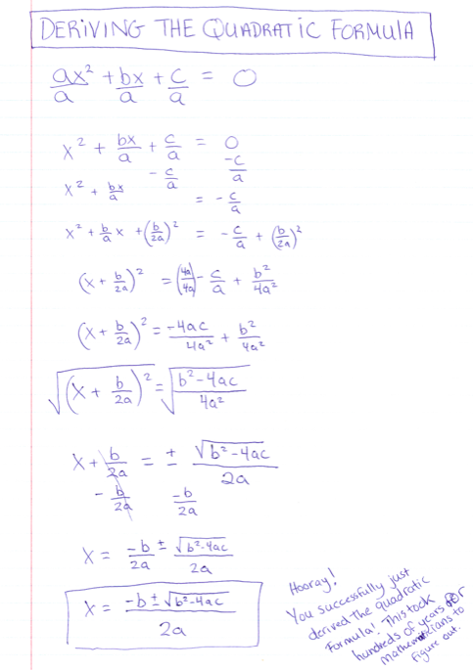

Slide 4
Chapter 3 Layout
Polynomials:
Part 1: Quadratic Functions
Part 2: What are polynomials - classifying, graphing, describing important points?
Part 3: Dividing Polynomials
Part 4: Real Zeros of Polynomials
Part 5: Complex zeros of Polynomials and the Fundamental Theorem of Algebra.
Part 6: Rational Functions

Slide 5
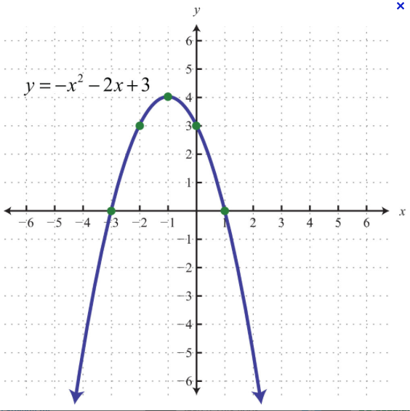
Tell Me Everything You SEE!

Slide 6
Polynomials!
Polynomials are the sum of monomials. We will look at polynomial functions of ALL degrees! Exponents are whole numbers.
A polynomial function is in the form:
P(x) = a_{n}x^{n} + a_{n-1}x^{n-1}+……. a₁x + a₀
A_{n,} the coefficient of the highest degree, is the called the leading coefficient.

Slide 7
Graphs of Polynomial Functions (Important Features)
Continuous – No breaks or holes. No cusps or Corners.
Degree:

Slide 8
END BEHAVIOR OF ODD DEGREE POLYNOMIALS
Polynomial has Odd Degree
Leading Coefficient:
Positive! Negative!

Slide 9
END BEHAVIOR OF EVEN DEGREE POLYNOMIALS
Polynomial has EVEN Degree
Leading Coefficient:
Positive Negative

Slide 10
Example 1:
Determine the end behavior of the polynomial. Sketch a graph to confirm.

Slide 11
Example 2:
Determine the end behavior of the polynomial
P(x) = 3x⁵ – 5x³ + 2x
Confirm that p and its leading term Q(x) = 3x⁵ have the same end behavior by graphing them together.

Slide 12
ZEROS OF A POLYNOMIAL FUNCTION
SKETCH A GRAPH OF THE POLYNOMIAL.
F(x) = (x + 2)(x - 3)(x + 5)

Slide 13
Bounces and Passes

Slide 14
HW #14: Intro to Polynomials
Section 3.2 Pg. 243-244 #9-to-14, 16, 17, 25

