Slide 1
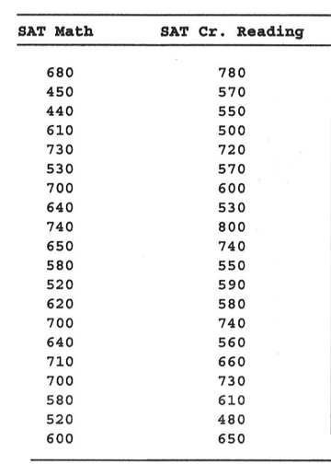
AP STATS: Warm-Up
Do Math SAT scores help to predict Verbal SAT scores. Make a scatter plot. Find the least squares regression and r and r-squared. Also graph the residuals. Use L3 (Y1(L1)) and L4 (L2-L3) to do so. Plot L1 vs. L4.
What is a residual?
What is the residual for the SAT math score of 680?

Slide 2
Agenda:
Today: R-Squared
Wednesday: Quiz on 3.2 and intro to 3.3
Thursday: 3.3 Lurking Variables/Review
Friday: No Class (half day)
Monday: Quiz on 3.3 – and Review for the Chapter 3 Test
Tuesday (11/5): Chapter 3 Test
Wednesday: DROP
Thursday (11/7): Project 2 is Due
Friday (11/8): No Class (Parent-Teacher Conferences)

Slide 3
Idea of the Day: Regression towards the mean.
Named after Sir Francis Galton.
He found that the kids of taller-than-average parents tend to be taller on average, but not as tall their parents. Hmmm…
I will post a chapter from a book called “Thinking Fast and Slow” by Daniel Kahneman about this. It’s a really interesting idea.
This explains why athletes having a spectacular year tend to do poorly the next year and why sick people tend to get better (regardless of the type of treatment).

Slide 4
Some Notes on the Project:
-Be formal and scientific in your writing (for the most part).
i.e. don’t say “I have no clue.” Try to avoid being colloquial.
-Summarize your descriptive stats (mean, median, middle 50%) in the results (if it is relevant). Actually restate the numbers here that are relevant and meaningful.
-Print and edit. It’s the only way to catch blunders.
-Be explicit in your method. Who did you ask, what was your question, how did you conduct the study?
-No need to comment on which graph looks best (i.e. a histogram versus a boxplot). By choosing the graph, the reader can assume that you chose wisely.
-Choose graphs wisely. What are you trying to show? What type of display shows this result best?
-Make subheadings for each part of your paper (intro, method, results, conclusion).
-Be careful in drawing conclusions. Just because you see a difference doesn’t mean that it’s conclusive evidence (we need more formal ways to analyze data before we can make those claims sometimes).

Slide 5
The role of r² in regression
r² – also known as the coefficient of determination.
-It is true that r² is the square of r, but there is more to the story.
The big idea of r²: How much better is the least squares line at predicting responses (y) than if we just used y-bar (the mean) as our prediction of every point.
**r measures the strength of a linear relationship and r² tells you how much better the linear model is at predicting y-values than simply using y-bar (the mean of y).

Slide 6
Saying it in words.
Say that the r² for a car’s age versus the value of the car is 45%.
This means that 45% of the variation in a car’s value is explained by the least squares regression line relating car age to car value.
SIMPLY PUT: it is the percentage of the response variable variation that is explained by a linear model.

Slide 7
Formula for r²
SST =
SSE =
Total sum of Squares
Sum of Squared Errors
(i.e. the sum of the residuals squared)
The fraction of the variation in the values of y that is explained by the least squared regression
on the other variable.

Slide 8
Facts about Least Squares Regressions
The distinction between explanatory and response variable is essential in regression. You will get a different regression line if you reverse the variables.
Recall that the least square regression line always passes through (x-bar, y-bar)

Slide 9
You Try!
3.44) A study of class attendance and grades among first year students at a state university showed that in general, students who attended a higher proportion of their classes earned higher grades. Class attendance explained 16% of the variation in grade index among the students. What is the numerical value of the correlation between between percent of classes attended and grade index?

Slide 10
Classwork/Homework 23
Read the section 3.2 review
Complete 3.43, 3.53, 3.55.
Optional: 3.58 (a bit tricky).

