Slide 1
AP STATS: WARM UP
Use your calculator to make a scatter plot of the long jump data. Find the linear regression that fits the model and make sure that it is graphed in your Y1. Also calculate the mean and standard deviation of each of the variables (year and distance jumped). Predict the long jump distance in 2016.

Slide 2

Friday Video
LA thinks it’s soooo cold.

Slide 3
Residuals
A residual is the difference between an observed value of the response variable and the value predicted be the regression line.
Residual = observed y – predicted y
          = y – y-hat
Residuals tell us how far the data lies from the regression line. Some are negative
(below the line) and some are positive (above the line).
THE SUM OF THE LEAST SQUARES RESIDUALS IS
ALWAYS ZERO!!

Slide 4
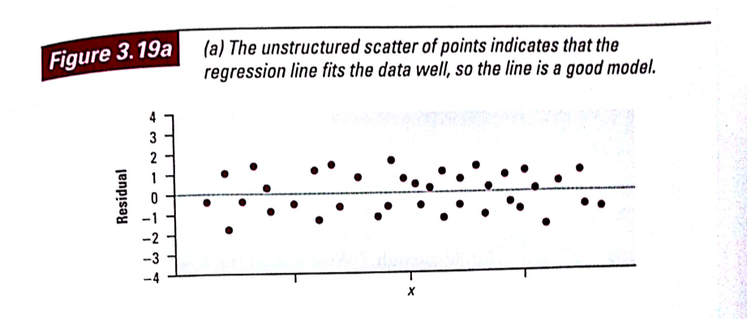
Residual Plot
A scatterplot of the regression residuals against the explanatory variable (or alternatively against the y-hat – predicted y-values).
**It allows us to tell how well a line fits the data.
**It MAGNIFIES the deviations from the line to make patterns easier to see.

Slide 5
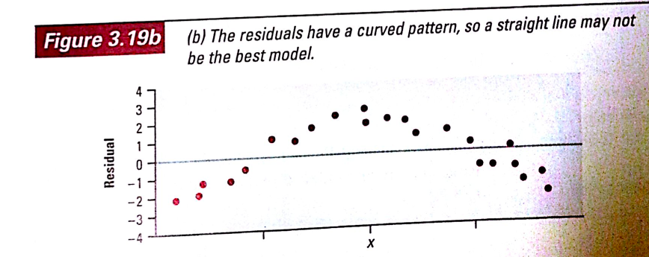
IMPORTANT THINGS TO REMEMBER WHEN LOOKING AT RESIDUAL PLOTS.
1.) The residual plot should show no obvious pattern!
(a curved pattern shows that the relationship is NOT linear).

Slide 6
Another Thing
2.) The residuals should be relatively small in size. How do we decide if the residuals are small enough?
FIND THE STANDARD DEVIATION of the RESIDUALS (which is basically a TYPICAL prediction error.
ALSO CALLED THE STANDARD ERROR OF ESTIMATE (SEE)
It is a judgment call. You have to decide if you are OK using a model that is typically OFF by a certain amount (the standard deviation of the residuals).

Slide 7
MC Question 1

Slide 8
MC Question 2

Slide 9
Multiple Choice 3

Slide 10
2.) D 3.) B 4.) E

Slide 11
Making a Residual Plot with your graphing calculator
Use the long jump data. Make sure that your linear regression is graphed in Y1.
Highlight L3 and type the command Y1(L1).
Define L4 as the observed y-value – predicted y-value (i.e. highlight L4 and enter the command L2-L3.
Now turn on Plot 1 and have it plot L1 and L4.
Hit Zoom #9

Slide 12
HW 22
Finish reading section 3.2
3.39 and 3.40

