Slide 1
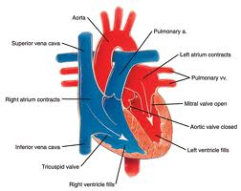
Honors Precalculus: Do Now
Each time your heart beats, your blood pressure increases, then decreases as the heart rests between beats. A certain person’s blood pressure is modeled by the function:
P(t) = 112 + 22 sin (120πt)
Where p(t) is the pressure in mmHg at time t, measured in minutes.
a.) Find the amplitude, period and frequency of p.
b.) sketch a rough graph of the function (show the y-intercept and important features only)
c.) If a person is exercising, their heart beats faster. How does this affect the period and frequency of p?

Slide 2
Video of the Day!
One Shining Moment
Fun facts:
The average human heart beats 100,000 times per day! And 2.5 billion times in a lifetime.
The heart weighs only 11 ounces but pumps 2000 gallons of blood through 60,000 miles of blood vessels each day.

Slide 3
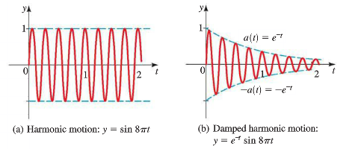
Damped Harmonic Motion

Slide 5
The Final 4: Whiteboard Madness
2 Rounds:
Round 1: Whiteboards Round
Round 2: Trashketball Graphing Round:
1st Place: Get out of HW free pass
2nd Place: Get out of Do Now free

Slide 6
Whiteboard Question
The top floor of a building undergoes damped harmonic motion after a sudden brief earthquake. At time t= 0 the displacement is at a maximum, 16cm from the normal position. The damping constant is c =0.72 and the building vibrates 1.4 cycles per second.
a.) find a function to model the motion.
b.) graph the function (very rough)

Slide 7
Optional
Complete the Ch. 5 Test
Complete Review Problems

