Slide 1
AP STATS: Quiz
Let’s start the class with our 3.3 quiz.
I won’t be collecting HW until tomorrow.
We will spend the rest of class reviewing for the Chapter 3 Test

Slide 2
Reminders:
Chapter 3 Test tomorrow
Project due Thursday
We will be completing course evaluations on Thursday. If you complete this at home, than you will have 15 minutes of free class time on Thursday. You may also use the 15 minutes in class on Thursday to complete this.

Slide 3
STATS LADDER

Slide 5
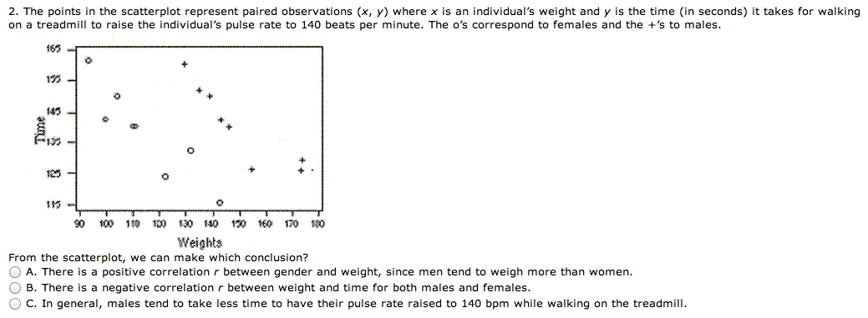

Slide 8
Trivia Question 1 point
Where did the expression “the whole 9 yards” come from?

Slide 12
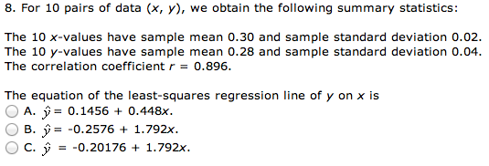

Slide 14
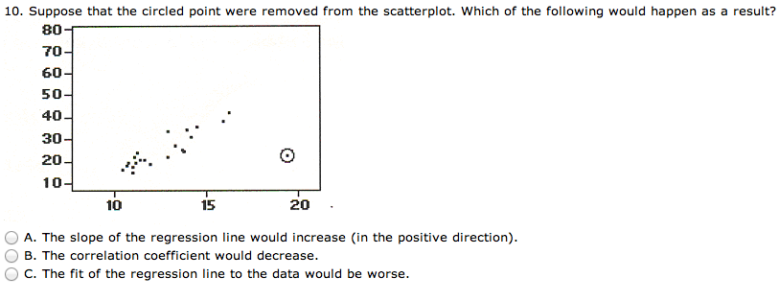

Slide 15
Trivia
What company did student t work for?

