Slide 1
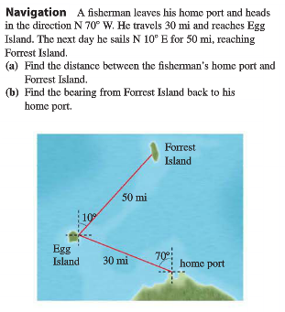
Review for the Ch. 6 Test
We will be doing a review game for the Ch. 6 Test (which is Friday). Start by completing the following warm-up problem below.
You have your trig quiz, homework and review problems to help you study.

Slide 2
Video of the Day

Slide 3
Question 1: Find the exact Value

Slide 4
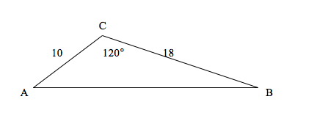
Question 2: Solve the Triangle

Slide 5
Question 3: Solve the Triangle

Slide 6
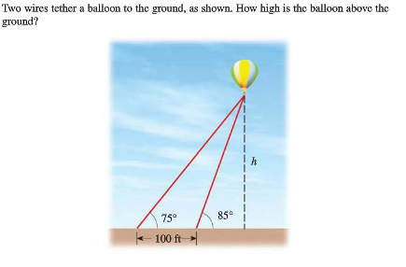
Question 4:

Slide 7
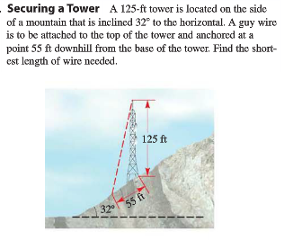
Question 5:

Slide 8
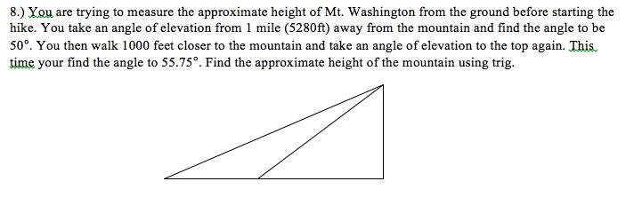
Question 6:

Slide 9
Question 7:
Find the exact value.

Slide 10
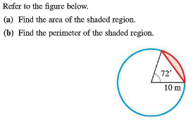
Question 8:

Slide 11
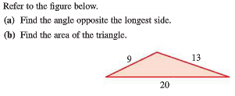
Question 9:

Slide 12
Question 10: Solve for x.

