Slide 1
Honors Precalc: Trig – Mile 2 of the Marathon!
1.) Convert this angle to radians
2.) Convert this angle to degrees
2.) Find angles (how about 2) that are coterminal with the angle in standard position
Find the area of a sector of a circle with central angle if the radius of the circle is 16 miles.

Slide 2
Angles Video
Fact of the day!
Hipparchus (140BC) is considered the founder of trigonometry. He constructed tables for the sine function. He used the tables to calculate the path of the planets.

Slide 3
ALL the Trig Ratios

Slide 4
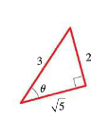

Slide 6
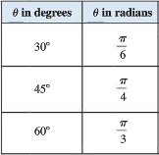
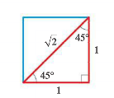
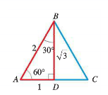
Our Special Right Triangles/Trig Ratios
30-60-90 45-45-90
Mention using your calculator here.

Slide 7
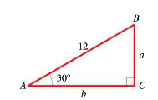
You Try: Solve the Triangle:
To solve a triangle simply means to determine all the parts (all angles and all sides).

Slide 8
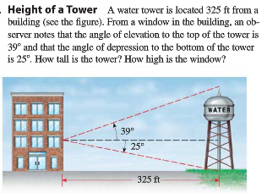
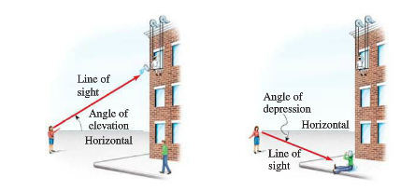

Slide 9
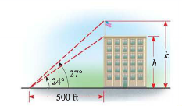
Angles of Elevation Example
From a point on the ground 500 feet from the base of a building, an observer finds
that the angle of elevation to the top of the building is 24° and that the angle of elevation to the top of a flagpole atop the building is 27°. Find the height of the building and the length of the flagpole.

Slide 10
Another way to measure…

Slide 11
Whiteboards:
Every Question you get correct, means one less problem that you have to solve on your homework.

Slide 12
Tomorrow
Download a free clinometer app for your smartphone. We are going to be using it tomorrow outside.

Slide 13
HW #10: Right Triangle Trig
Section 6.2: pg. 484-487: #3, 6, 9, 11, 14, 16, 19, 32, 47, 55, 58

