Slide 1
WARM UP: Penny Sampling
1.) Take a look at the graphs that you made yesterday. What are some intuitive takeaways just from looking at the graphs?

Slide 2
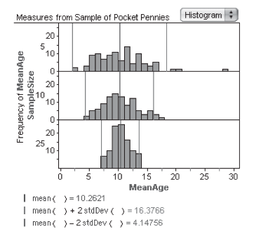
SIMILAR RESULTS
Sampling means and why they’re useful

Slide 3
What is the Central Limit Theorem?
The central limit theorem in it's shortest form states that the sampling distribution of the sampling means approaches a normal distribution as the sample size gets larger, regardless of the shape of the population distribution. So the sample means will be normally distributed (especially when the sample is above 30) if the population is positively skewed, negatively skewed or even binomial (having only 2 outcomes).
Why it’s so important?
The key to inference:
-Confidence Intervals and Hypothesis Testing
-Allows us to make definitive statements about SAMPLE MEANS and PROPORTIONS (every consumer product that you use undergoes quality control using this methodology).
-Allows to determine if a result from a study is significant.

Slide 4

Video of the Day
http://vimeo.com/75089338

Slide 5
WHAT”S IN STORE FOR THE SECOND SEMESTER!
What we have already covered:
Displaying distributions with graphs (histograms, ogives, etc)
Describing distributions with numbers (mean, std dev, etc)
Density curves and normal distributions
Scatter plots
Least square regression
Transforming to achieve linearity
Categorical variables
Establishing causation
Designing samples and experiments
Simulation and probability
Discrete and continuous random variables
Means and variances of random variables
Binomial and geometric distribution
What’s in store for the 2nd Semester! – ALL ABOUT INFERENCE
-The sampling distribution (sample means and proportions) – TEST NEXT WEEK
-Confidence Intervals
-Significance Testing
-Comparing means and proportions
-Chi Square
-Inference for Regression
THE AP EXAM AND A FINAL PROJECT (7th Period)!!

Slide 6
Important Review Concept
Parameter: a number that describes the population. Most often, this is not known.
Statistic: a number that can be computed from a sample. Oftentimes used to estimate the population parameter.
Sampling variability: the value of a statistic varies in repeated random sampling (think of the pennies)

Slide 7
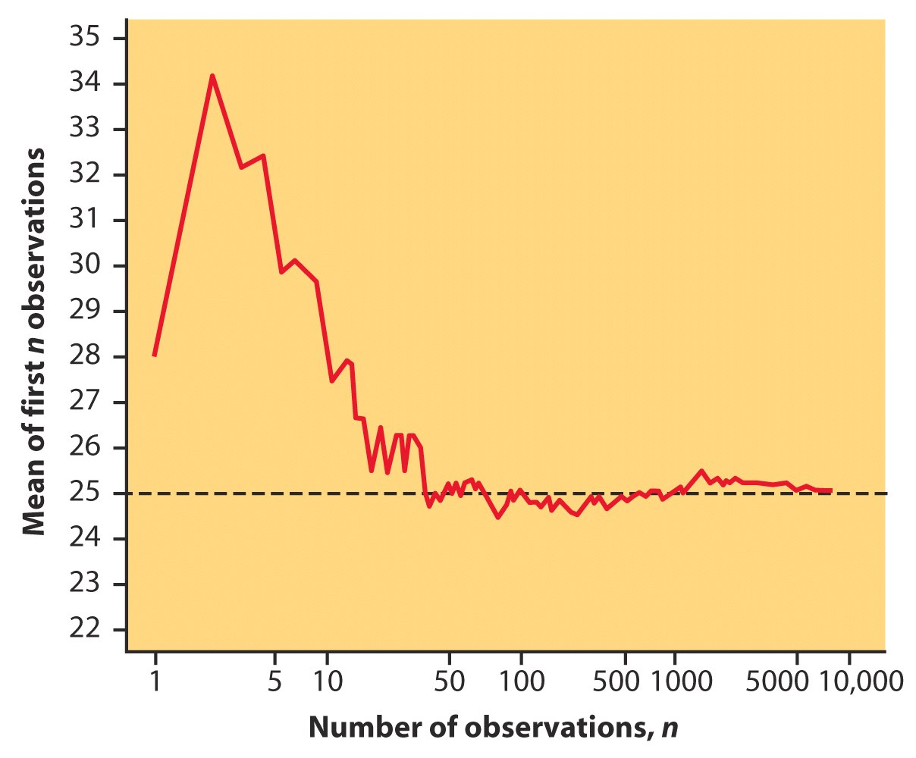
Remember the Law of Large Numbers: How sample means approach the population mean (μ=25).

Slide 8
THE SAMPLING DISTRIBUTION
The sampling distribution of a statistic is the distribution of values taken by the statistic in all possible samples of the same size from the same population.
Think of rolling a die 5 times (repeatedly) and calculating the mean of each sample of size 5 and plotting a histogram.

Slide 9
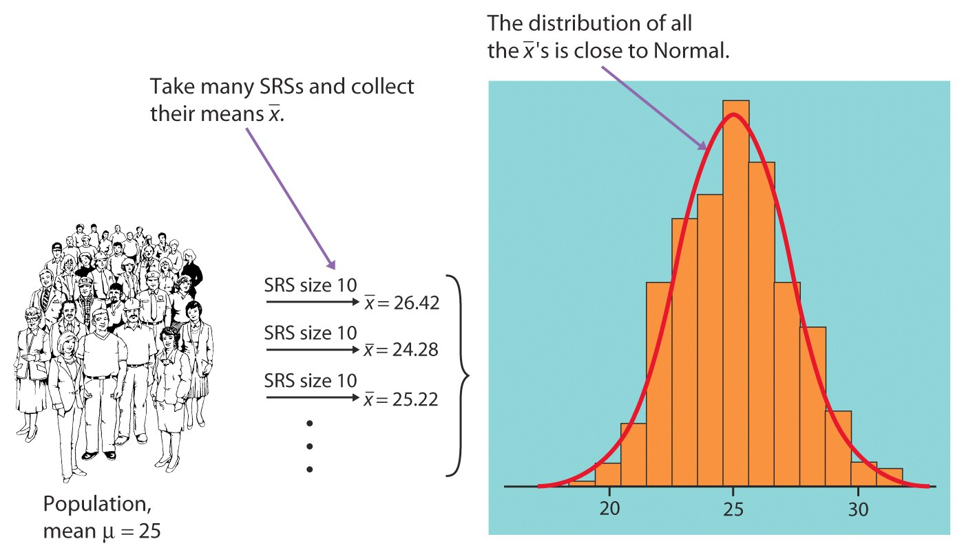
what would happen in many samples?

Slide 10
Describing Sampling Distribution (SOCS)

Slide 11
Unbiased Statistic/Estimator
A statistic used to estimate a parameter is unbiased if the mean of its sampling distribution is equal to the true value of the parameter being estimated.
The statistic is called an unbiased estimator if so.

Slide 12
Variability of a Statistic
Described by the SPREAD of its sampling distribution. Determined by the SIZE of the sample.
LARGER SAMPLES HAVE SMALLER SPREAD (surprise, surprise).
Power of Statistics:
***As long as the population is much larger than the sample (say at least ten times as large), the spread of the sampling distribution is approximately the same FOR ANY POPULATION SIZE.***
This is good news the US but bad news for Providence.

Slide 13
BIAS AND VARIABILITY

Slide 14
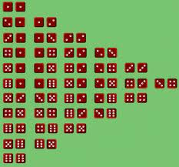
HOMEWORK #2: Sampling Distribution
Read section 9.1
Exercises: 9.11, 9.12, 9.13, 9.15, 9.17,
For 9.15

