Slide 1
AP STATS WARM UP
Look over your test.
Mean: 89.73
Standard DevIation:9.55
1.) What percent of test takers scored a B+ OR better (i.e. an 87 or above).
2.) Take your ruler and measure your hand span (hands fully spread, the distance from the tip of your thumb to the tip of your pinkie) in inches. Then put this and your height in inches on the board.

Slide 2
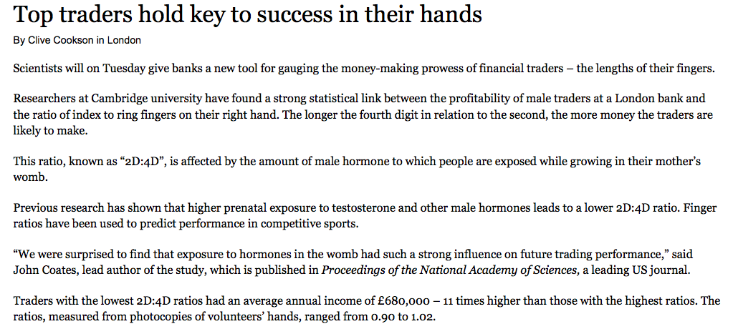
Idea of the Day

Slide 3
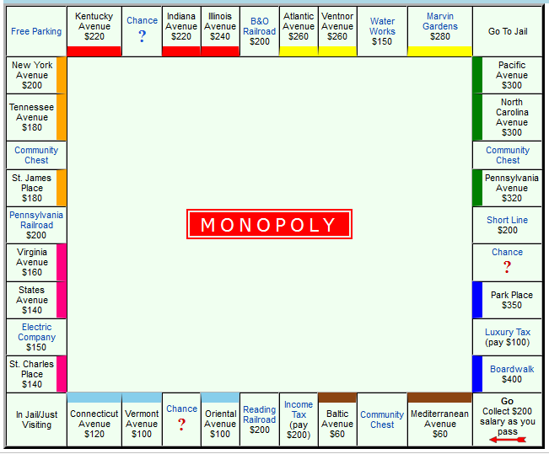
Scatter Plots: Fill in the table below and graph it to see the relationship between the distance from Go and the cost of properties on a standard Monopoly board. Find the line of best fit when all data points have been graphed.

Slide 4
Bivariate Data
We often are interested in seeing how changes in one variable (the explanatory variable) result in predictable changes in some other variable (the response variable).
In this chapter we will focus on both variables being quantitative.
Response Variable: Measures an outcome (y – axis)
Explanatory Variable: Helps to influence changes in the response variable (x –axis)
IMPORTANT NOTE: Calling one variable explanatory and the other response does NOT necessarily mean that changes in one variable CAUSE changes in the other.

Slide 5
Scatter Plots
Show the relationship between two quantitative variables measured on the same individuals. Each point represents the response for that individual for both variables.

Slide 6
Adding in a categorical variable

Slide 7
Interpreting Scatter Plots:
Direction, Form, and Strength
1.) Look for the overall pattern and for striking deviations from that pattern.
2.) Describe the overall pattern by noting the direction, form and strength of the relationship.
3.) An important deviation is an outlier, an individual that falls outside the overall pattern of the relationship.
Direction: positive or negative
Form: clusters, curves, linear, quadratic, cubic, etc.
Strength: A measure of how closely the points follow a clear form (given by an r value)

Slide 8
Let’s Try One.

Slide 9
Homework 18
Read Section 3.1 (page 168-185)
Complete Exercises: 3.2, 3.5, 3.8, 3.9

