Slide 1
Honors Precalculus: Do Now
State the period and an phase shifts. Then graph the following tangent function.
Y = tan 2(x + $\frac{π}{2})$

Slide 2
Quote of the Day
We are what we repeatedly do. Excellence,
then, is not an act, but a habit.
Aristotle

Slide 3
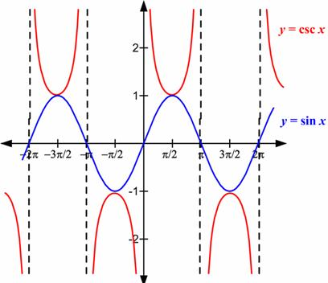
Graphing y = csc (x)
Below is the graph of the cosecant function. Discuss with a neighbor what is happening on the
Graph of the cosecant function and what the period of the function is.

Slide 4
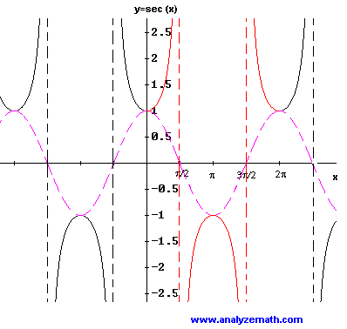
Graphing y = sec (x)
Below is the graph of the secant function. Discuss with a neighbor what is happening on the
graph and what the period of the function is.

Slide 5
Graphing Transformations
Y = a csc k(x + b)
y = a sec k(x + b)

Slide 6

In groups you will have to graph the function and explain your graph to the class. Graph at least 3 full periods.
Y = ½ csc 2x
Y = ½ csc (2x + $\frac{π}{2})$
Y = 3 sec $\frac{1}{2}x$

Slide 7
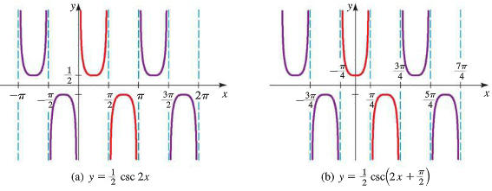
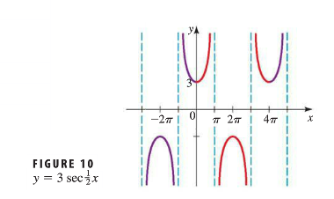

Slide 8
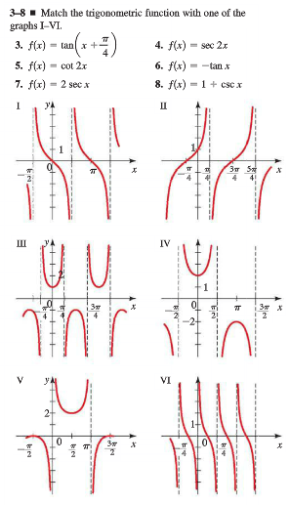
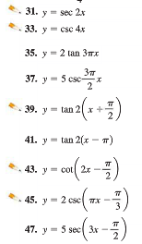
HW #17: Secant and Cosecant Functions
Work in your same groups to start the HW
Section 5.4 Page 405 #3-8, 15, 31, 45, 47, 57

