Slide 1
Honors Precalculus: Do Now
Find the nth term of the sequence whose first several terms are given.
Find the first 4 terms of the given recursively defined sequence.
And a₁= -8

Slide 2
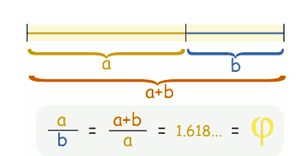
Another Video on Fibonacci and the Golden Ratio!

Slide 3
Partial Sums of a Sequence
In calculus we are often interested in adding the terms of a sequence.

Slide 4
Example 1: Finding the Partial Sums of a Sequence
Find the first 4 partial sums and the nth partial sum of the sequence given by a_{n}=1/2^{n}.

Slide 5
Example 2: Finding the Partial Sums of a Sequence
Find the first 4 partial sums and the nth partial sum of the sequence given by a_{n}=

Slide 6

SIGMA NOTATION

Slide 7
Example 3: Sigma Notation

Slide 8
Example 4: Writing Sums in Sigma Notation
Write each sum using sigma notation.
a.) 1³ + 2³ + 3³ + 4³ + 5³ + 6³ + 7³
b.)

Slide 10
HW #45: Partial Sums
Read the end of section 12.1
Section 12.1 #37, 38, 39, 41, 46, 47, 55, 62, 64, 74

