Slide 1
Read the Intro
To Chapter 6:
Case Closed.
This Unit is all about
Probability

Slide 2
There’s a good chance that the Test will be curved…
So far the most number of MC questions correctly answered is 8 out of 10.

Slide 3
Estimating the Number of Fish in a Lake
1.) “Catch” a sample of fish and TAG them.
2.) Put the tagged fish them back in and then “catch” a second sample.
3.) Count the number tagged in the second catch over the number total.
4.) Use this proportion to solve for the total number of fish in the lake.

Slide 4
Simulation
Toss a coin 3 times – likelihood of a run of 3 or more consecutive heads or tails?
A couple plans to have kids until they have a girl or 4 children? What are the chances that they will have a girl?
Airlines overbook their flights because they know that a certain percentage won’t show. What is the probability that more ticketed passenger will show than they have seats?
We can answer questions like these in several ways:
1.) Estimate the probability by actually observing the random phenomenon.
2.) Develop a probability model and use it to calculate a theoretical answer.
3.) Start with a model that reflects the truth about the phenomenon and then
Simulate a number of repetitions.

Slide 5
Simulation
Simulation is the imitation of chance behavior, based on a model that accurately reflects the phenomenon under consideration.
Oftentimes this is easier than creating a probability model for a complex problem.
In 6.2 and 6.3 we will learn some of these methods.

Slide 7
A couple plans to have children until they have a girl or until they have 4 children, whichever comes first.

Slide 8
Complete the same task with a calculator…
Random Integer Generator

Slide 9
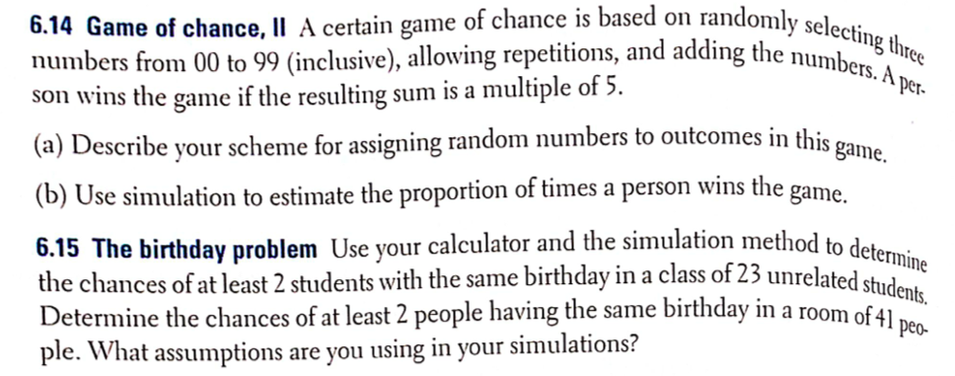
YOU TRY!!!

Slide 10
Homework
The HW will be posted online. It is a worksheet to be printed out. I should have a copy by the end of the day.

