Slide 1
Honors Precalculus: Do Now
Graph the function below by hand. Be sure to factor the function, find the horizontal and vertical asymptotes, and the x and y-intercepts . Only use a graphing calculator at the very end to confirm your answer. REMEMBER FAITS!!

Slide 2
After Today!
You will be able to graph rational functions with holes, slant asymptotes and parabolic asymptotes.
Your homework for this weekend will be to complete a graded HW (worth 30 points –on section 3.5-3.7).
Monday: Applications of Polynomial Functions
Tuesday: Review
Wednesday: Chapter 3 Test

Slide 3
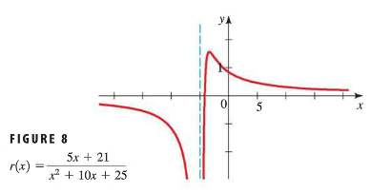
A Funky One

Slide 4
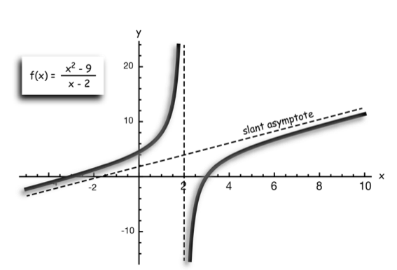
Slant Asymptotes
A slant asymptote will be present if the degree of the numerator is one higher than the degree of the denominator.
To find the equation of the slant asymptote, divide the numerator by the denominator and discard any remainder. The quotient, the equation of a line, is the equation of the slant asymptote.

Slide 5
Example 1: graph the rational function below

Slide 6
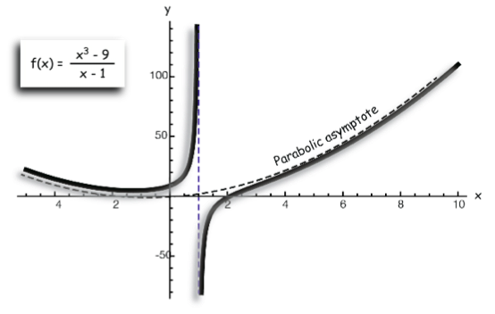
Parabolic Asymptotes
When the degree of the numerator of a rational function differs by more than one from the degree of the denominator, the function will have curved asymptotes.

Slide 7
Example 2: graph the rational function below listing any asymptotes and intercepts.

Slide 8
Example 3: Holes!
It is even possible to have a hole in a rational function.
Take for example this function:

Slide 9
Some Reminders!
1.) If n < m the function will have a horizontal asymptote at y = 0.
2.) If n = m, the function will have a horizontal asymptote at y = a/b. (where a is the leading coefficient of the numerator and b is the leading coefficient of the denominator).
3.) If the degree of the numerator is one larger than the degree of the numerator, the function will have a linear (slant) asymptote.
4.) If the degree of the numerator is two (or more) larger than the degree of the denominator, the function will have a curved asymptote. For example, if the degree of the numerator is 3 and that of the denominator is one, the function will have a parabolic asymptote.

Slide 10
GRADED HOMEWORK (30 points)! which you may start in class….
You may use your textbook, notes, and even a graphing calculator to check your work.
You may EVEN work with a partner to complete these problems.
Be sure to SHOW all work. This means showing how you found your asymptotes, how you determined what happened at the extremes and near the asymptotes.

