Slide 1
Honors Precalculus: Do Now
1.) Solve for angle A in triangle ABC if a = 26 c = 15 and <C = 29°
2.)

Slide 2
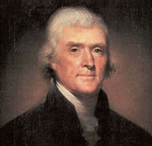
Quote of the Day
“I am not an advocate for frequent changes in laws and Constitutions. But laws and institutions must go hand in hand with the progress of the human mind. As that becomes more developed, more enlightened, as new discoveries are made, new truths discovered and manners and opinions change, with the change of circumstances, institutions must advance also to keep pace with the times. We might as well require a man to wear still the coat which fitted him when a boy as civilized society to remain ever under the regimen of their barbarous ancestors.”

Slide 3
Law of Cosines Vs. Law of Sines
Law of Sines can be used if we know: ASA or AAS or SSA (but it’s ambiguous)
Low of Cosines: SAS or SSS

Slide 4
The Law of Cosines: Proof
a² = b² + c² – 2bc cos A
b² = a² + c² – 2ac cos B
c² = a² + b² – 2ab cos C
C
A
B

Slide 5
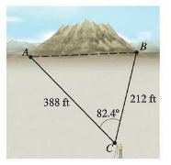
Example 1: Length of a Tunnel
A tunnel is to be built through a mountain. To estimate the length of the tunnel, a surveyor makes the measurements shown in the figure below. Use the surveyor’s data to approximate the length of the tunnel.

Slide 8
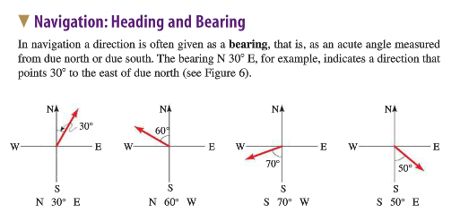

Slide 9
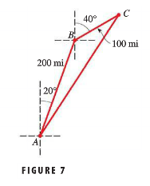

Slide 10
HW to REVIEW for the Ch. 6 TRIG TEST
While I will not CHECK this HW, these are the problems that I would suggest doing to review for the test on Friday. Again you certainly don’t need to do them all but I would do enough so you feel comfortable.
Chapter 6: review
Page 483-486 #1, 3, 7, 9, 11, 15, 17, 19, 21, 24, 28, 29, 32, 38, 41, 53, 65, 67, 73, 77, 78, 79, 82
OR
Ch. 6 Test (except #3 and #12)

