Slide 1
Honors Precalculus: Do Now
1.) Describe the transformation of the parent function.
G(x) = -2^{x+5} + 3
2.)A Sum of a $100 is invested into a super high yield CD (certificate of deposit) which yields 100% per year. Find the amount in the account after 1 year if it is compounded monthly, daily, or hourly (choose one of the 3)?.
3.) The Moses Brown paper has just come out with an amazing statistic. The tuition at Moses Brown is doubling every 12 years!!! That means, the tuition will be more than double from when you enter MB (in kindergarten) to when you graduate. Use the rule of 70 to approximate the rate of growth per year.

Slide 2
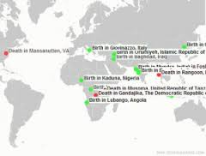
Idea of the Day!
A real time map of births and deaths!

Slide 3
Example 1:
A bacteria culture contains 1500 bacteria initially and doubles every hour.
a.) find the function that models the number of bacteria after t hours.
b.) Find the number of bacteria after 24 hours.
**Note-the same applies when we say increases by 50%.

Slide 4
The Annual Percentage Yield
When an investment earns compound interest, then the annual percentage yield is the simple interest: A=P(1+r) that yields the same amount at the end of one year.
Example: Find the annual percentage yield of an investment that earns interest at a rate of 6% per year, compounded daily.

Slide 5
Present Value
The present value of a sum of money is the amount that must be invested now, at a given rate of interest, to produce the desired sum at a later date.
Example: Find the present value of $10,000 if interest is paid at a rate of 9% per year, compounded semiannually, for 3 years.
This idea is used in pricing Bonds

Slide 6
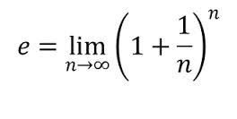
The number e
Euler’s Number:
2.7182818284590452353602874713527…
Definition: OR With Factorials
It is irrational
Called the natural exponential function.
Models 100% CONTINUOUS growth (i.e. what happens in nature).

Slide 7
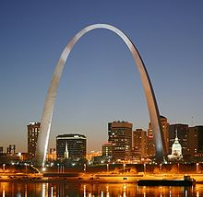
Some amazing facts about e
The derivative of e^{x} = e^{x}.
Like a Shakespearean sonnet that captures the very essence of love, or a painting that brings out the beauty of the human form that is far more than just skin deep, Euler's equation reaches down into the very depths of existence. It brings together mental abstractions having their origins in very different aspects of our lives, reminding us once again that things that connect and bind together are ultimately more important, more valuable, and more beautiful than things that separate.

Slide 8
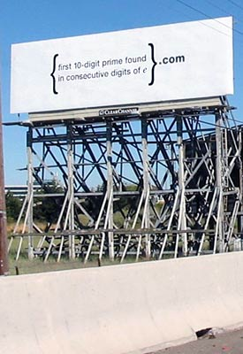
Another fun fact about e
For a few weeks after the appearance of the puzzle "7427466391.com" was the URL for a web site that invited those who got there to solve another puzzle, and then the answer to that puzzle was the password to enter yet another website which was an invitation to send in a CV and further explore the possibility of working for Google. A person who can solve those puzzles is a person of interest to Google.
The location of the answer:
2.71828182845904523536028747135266249 7757247093699959574966967627724076630 3535475945713821785251664274274663919 3200305992181741359662904357290033429 5260595630738132328627943490763233829 8807531952510190115738341879307021540 8914993488416750924476146066808226480 0168477411853742345442437107539077744 9920695517027618386062613313845830007 5204493382656029760673711320070932870 9127443747047230696977209310141692836 8190255151086574637721112523897844250 5695369677078544996996794686445490598 7931636889230098793127736178215424999 2295763514822082698951936680331825288 6939849646510582093923982948879332036 2509443117301238197068416140397019837 6793206832823764648042953118023287825 0981945581530175671736133206981125099

Slide 9
Spread of a Virus: Logistic Growth
An infectious disease begins to spread in a small city of population 10,000. After t days, the number of people who have succumbed to the virus is modeled by the function:
V(t) =
a.) how many infected people are there initially (time t=0)?

Slide 10
Spread of a Virus
An infectious disease begins to spread in a small city of population 10,000. After t days, the number od people who have succumbed to the virus is modeled by the function:
V(t) =
b.) Find the number of infected people after 1 day, 2 days, and 5 days?
c.) Graph the function of v and describe its behavior.

Slide 11
Continuously Compounded Interest
A(t) = Pe^{rt}
Find the amount after 3 years if $100 is invested at an interest rate of 12% per year, compounded continuously.

Slide 12
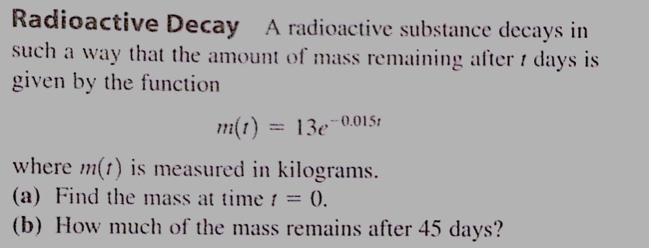
You Try!

Slide 13
Homework #38
Section 4.1:
#48, 56, 58
Section 4.2
#20, 21, 23, 25, 27, 31, 32

