Slide 1
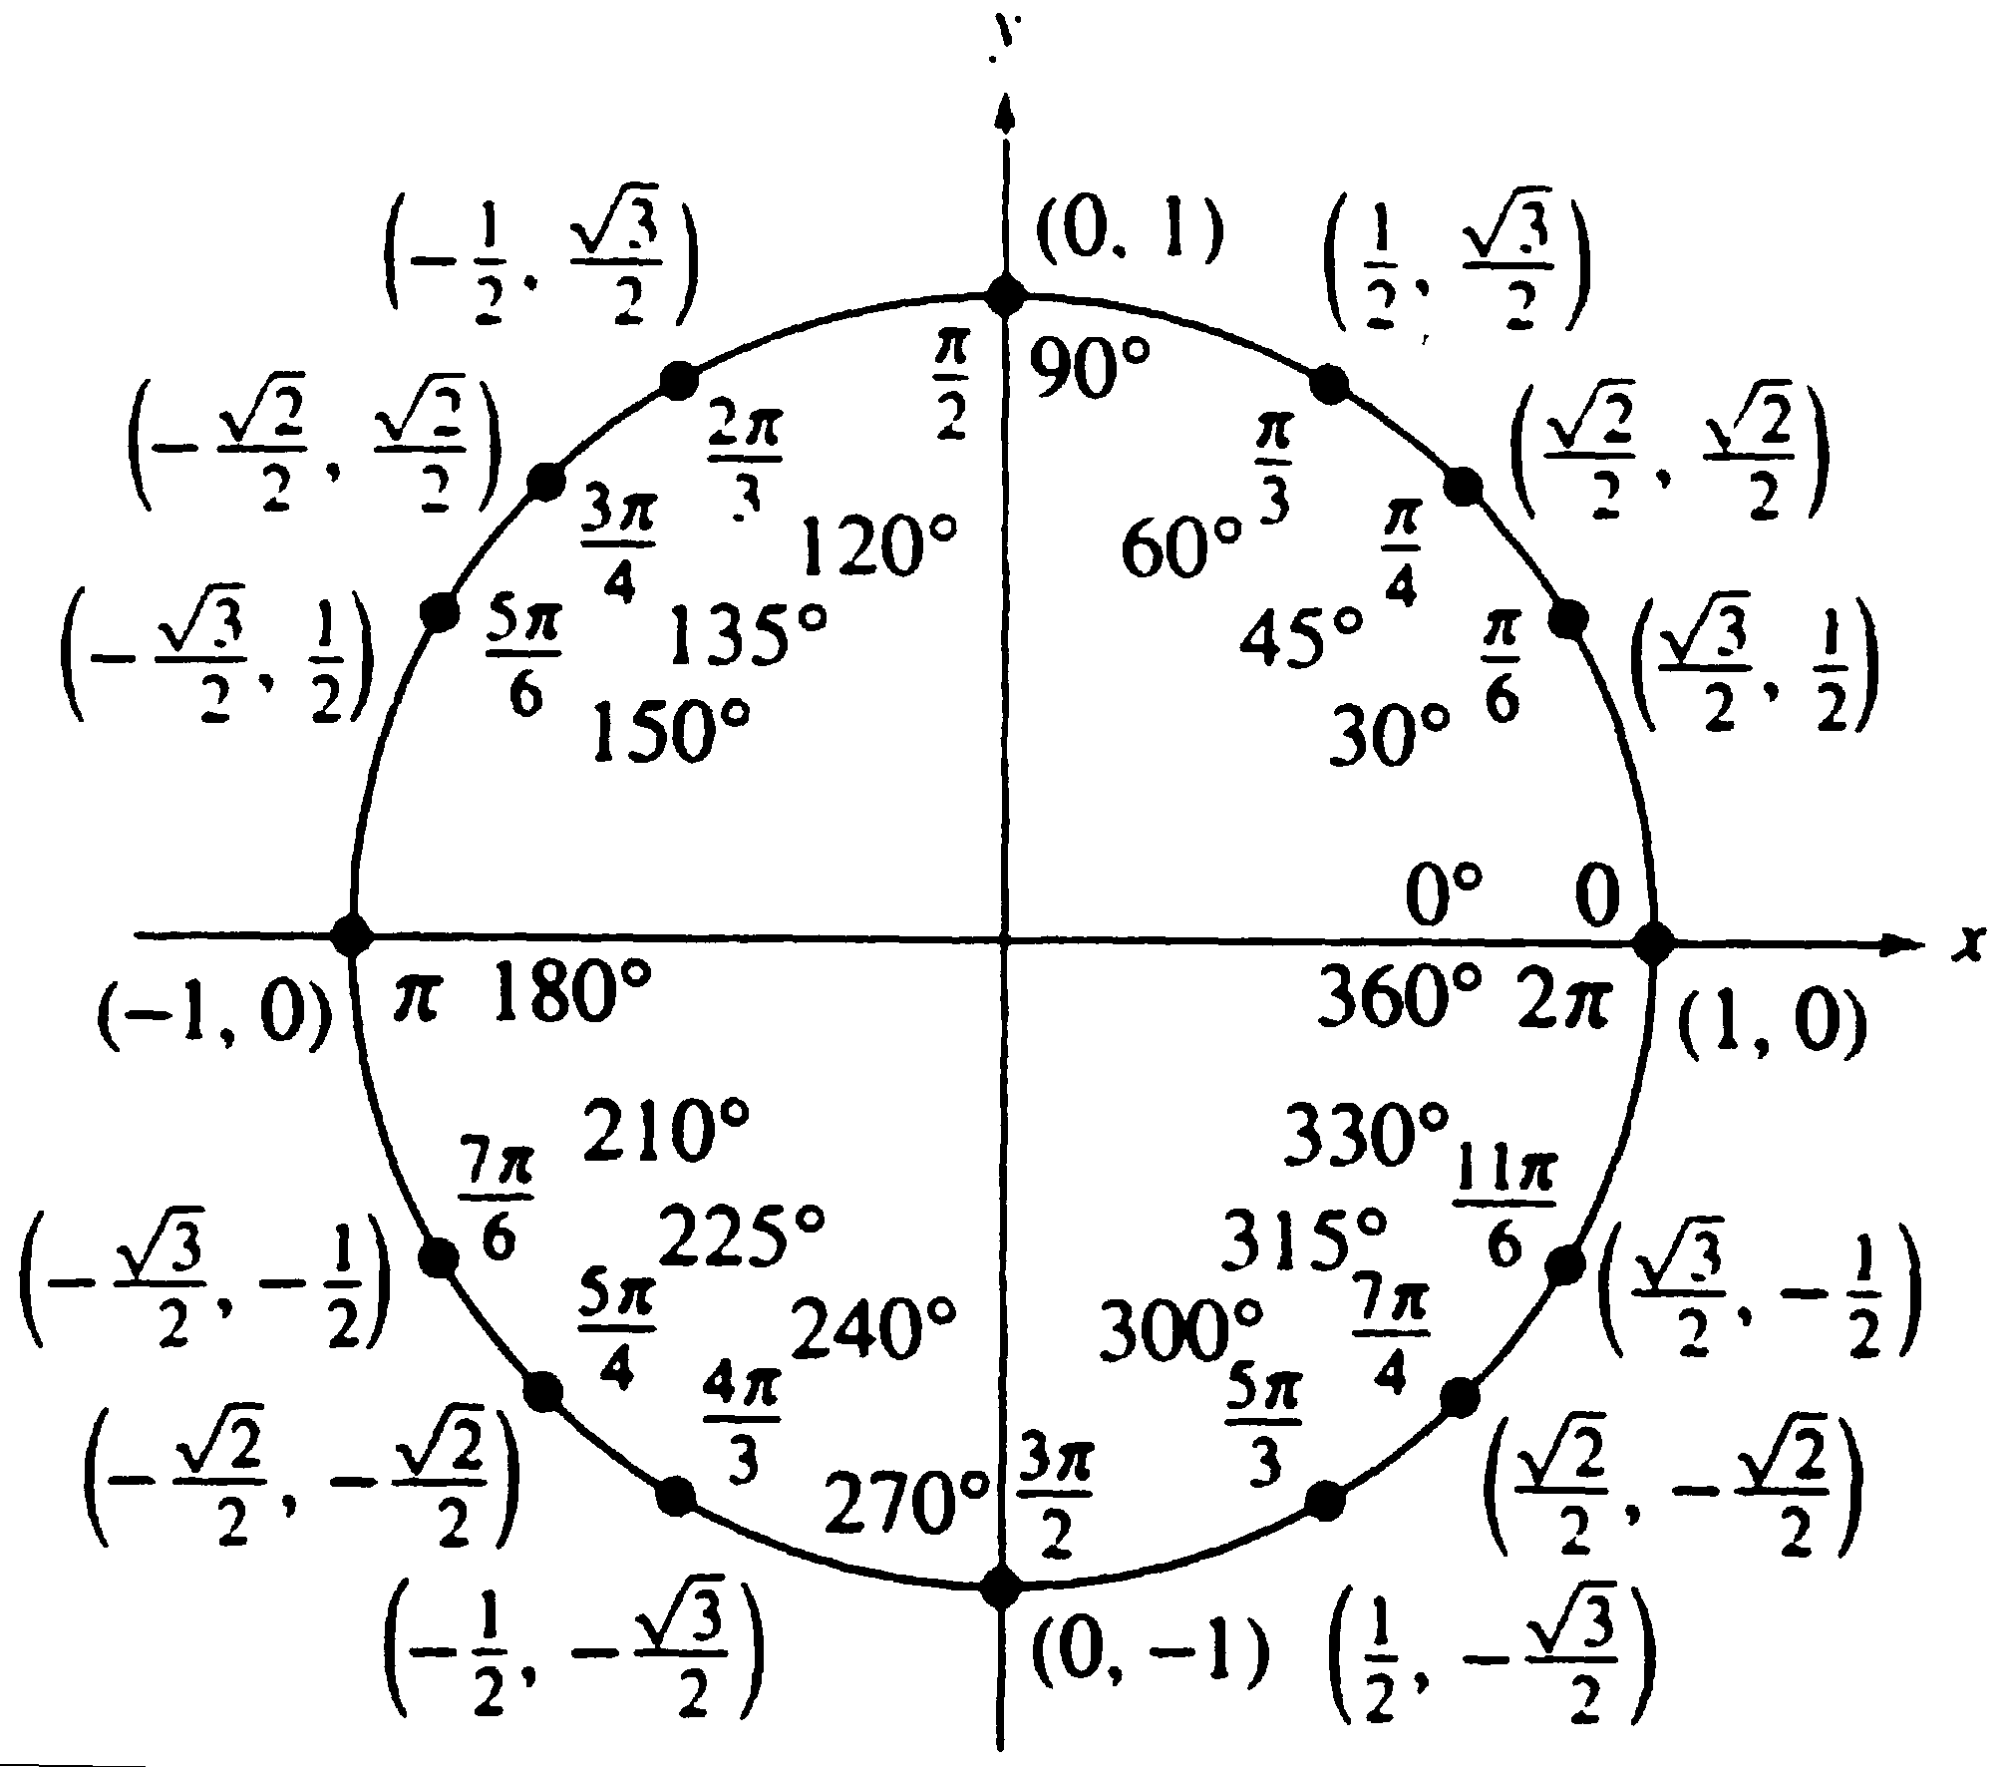
UNIT CIRCLE QUIZ
Take a minute to review your unit circle. We will take the quiz in just a moment.

Slide 2
UNIT CIRCLE QUIZ
PUT YOUR NAME ON THE BACK OF THE PAGE.
Make sure to fill in the radian measurements and the corresponding coordinate points (x, y) of the lines crossing the circle.

Slide 3
TAKE A QUIZ. GET A PEN. WRITE YOUR INITIALS IN THE BOTTOM RIGHT CORNER
LOOK AT THE UNIT CIRCLE ON THE BOARD.
CIRCLE ANY PLACE WHERE THE STUDENT GETS IT WRONG. ANYTHING DIFFERENT AT ALL.
HAND THE QUIZZES BACK IN ONCE YOU HAVE CAREFULLY CHECKED IT. IF YOU MISS CIRCLING A MISTAKE, YOU WILL LOSE A HALF POINT ON YOUR QUIZ.

Slide 4
UNIT CIRCLE:
Should look identical except for the degree measurements which you don’t need.

Slide 5
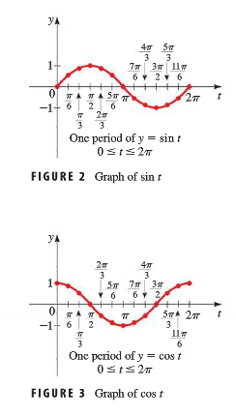
Reminder: Here’s what we did yesterday!

Slide 6
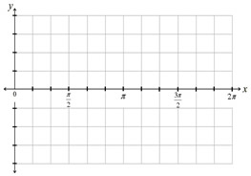
Translating the Sine and Cosine Functions
Sketch a graph of each of the following.
a.) f(x) = 2 + cos (x) b.) f(x) = -cos (x)

Slide 7
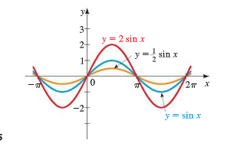
Amplitude
y = a sin x and y = a cos x
|a| is called the amplitude.

Slide 8
Sketching a Graph
Sketch a graph of y = 2 sin (x) and y = ½ sin (x)

Slide 9
Sketching a graph
Sketch a graph of y = -3 cos (x)

Slide 10
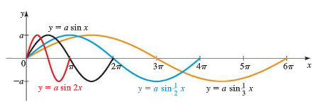
Period of Sine and Cosine Functions
y = a sin kx
The period is 2π/k

Slide 12
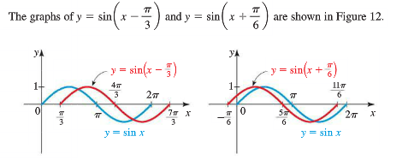
ALL THE SHIFTS TOGETHER

Slide 14
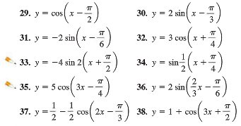
Classwork/Homework Assignment Handed in tomorrow!
Your job is to very neatly graph 2 shifted trig functions that will be displayed around the classroom. Use colors and indicate the amplitude, period and phase shift. Include at least one complete period. Don’t forget your name!
Page 396 #29-42 Choose 2!
OPTION 2: Spaghetti Sine/Cosine Curve

