Slide 1
Honors Precalculus: Do Now
Check your HW with a partner.
Can’t get enough… Try out another!

Slide 2
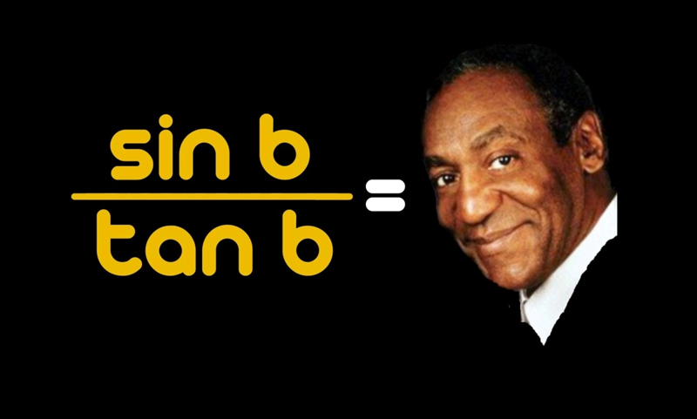
Dorkiest Math Jokes

Slide 3
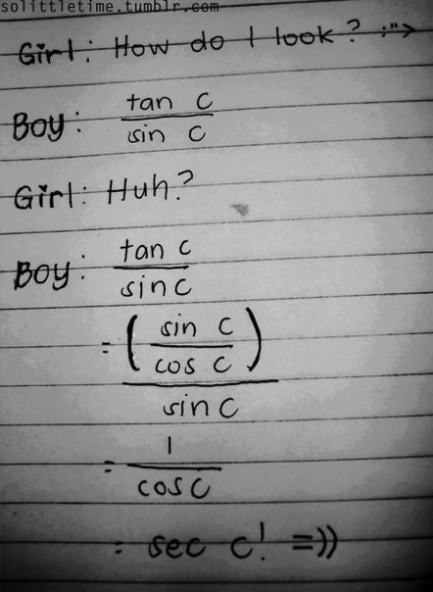

Slide 4
Einstein, Newton and Pascal decide to play hide and seek. Einstein is it, closes his eyes, counts to 10 then opens them.
Pascal is no where to be seen.
Newton is sitting right in front of Einstein, with a piece of chalk in his hand. He’s sitting in a box drawn on the ground, a meter to a side.
Einstein says “Newton, you’re terrible, I’ve found you!”
Newton says “No no, Einy. You’ve found one Newton per square meter. You’ve found Pascal!”

Slide 11
HW #21:
Section 7.1 (page 499-500):
27, 29, 31, 43, 44, 45, 75, 79

