Slide 1
AP STATS: Project
Take 5-10 minutes to brainstorm ideas for your final project. Proposals will be due on Friday (rough drafts will be peer edited on Thursday). Also, take a look at the overview of the project.
You may work alone or with one other person. Please don’t pressure people to work with you if they prefer to work alone.
If you already have an idea, start writing questions that you want to ask in a survey. Remember, your project should have a clear theme!
If you are doing an experiment, start writing your experimental design (or coming up with several ideas). Experiments can be done using a survey by the way….
You may use your computer to do this.
Chapter 11 Test is Wednesday.

Slide 2
Project
Project Outline
Part 1: Identify a Research Question and Design Your Study
Part 2: Collect Data – Observational Study or Experiment
Part 3: Analyze Data – Graphically and Numerically
Part 4: Perform Inference – Answer Research Question
Part 5: Present Findings (Write your Paper)
Part 6: Peer Editing
Part 7: Present Your Findings (Poster Day)

Slide 3


Slide 4
Why Confidence Intervals are becoming more preferred?
Why might you be skeptical if you just know that a result is significant or not significant, but nothing else?
What could cause a significant result even though the null is in fact true?

Slide 5
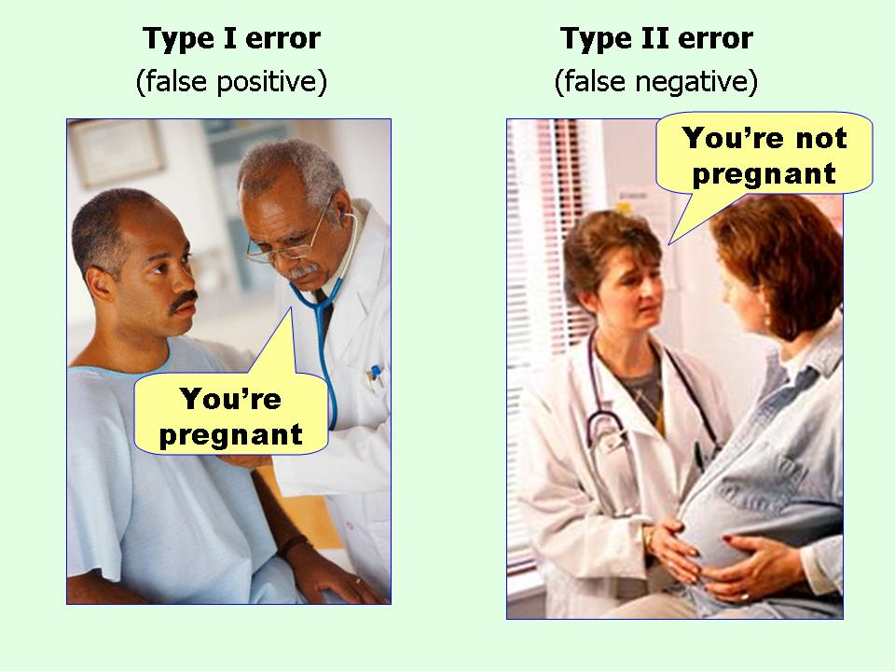
Type I and Type II Errors
Let’s say that you are serving on a grand jury trying to determine if someone is guilty of a serious crime. You decide that there is enough evidence to convict that individual of murder.
Type 1 Error (α): you reject the null hypothesis (H₀), but the null is actually true (H₀).
Type 2 Error (β): We fail to reject the null hypothesis (H₀), when the null hypothesis (H₀) is false.

Slide 6
EXAMPLE

Slide 7
Examples:
Example 1: Let’s say you are a doctor administering a test to a patient for a rare disease. The null is that the person does not have the disease.
What would be a type I error in this case?
What would a type II error be?
Example 2: Hurricane Sandy Evacuation.
Consequences: Which error is worse (more dangerous)? Depends on the situation?

Slide 8
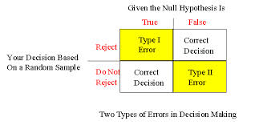
IMPORTANT: The α level is the probability
of a type I error.

Slide 9
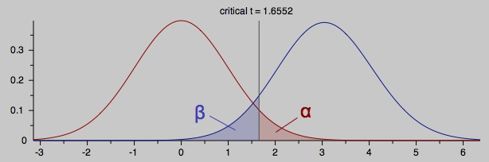
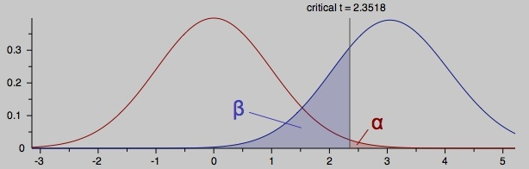

Slide 10
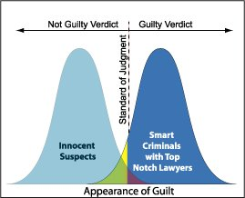

Slide 11
Power
-The POWER of a test is 1-β or 1 – (the probability of a type II error).
-The power of a test is the probability that the test will reject the hypothesis tested (H₀) when a specific alternative hypothesis is true.
-In plain English, it the probability of detecting a difference that does in fact exist!
-A major distinction between power and p-value. P-value assumes that the null is true. Power assumes that some alternative H_{a} is true.
-HIGH POWER IS FAVORABLE!!

Slide 12
Ways to Increase the Power of a Test
Increase α (i.e. from 0.01 to 0.05)
Increase the sample size.
Consider an H_{a} further from the H₀ (could just be hard to detect that the alternative is true because it is close to the hypothesized value).
Decrease σ (same effect as to increase sample size).
To make things simple, you should choose as high an alpha level as you are willing to risk, and as large a sample as you can afford!

Slide 13
Interpret This
“When money is being given out, liberals try to avoid Type II errors while
conservatives aim at reducing Type 1 errors. When punishment is being administered,
their roles may be reversed.”
How to Tell the Liars from the Statisticians

Slide 14
HW #13
Unit Test on Wednesday (start studying!!).
Rough Draft of Project proposals are due Thursday. Final Draft is due Friday.
Read 11.4
Complete Exercises 11.59, 11.61
To review for the Test (these are optional).
11.65, 11.66, 11.69, 11.71, 11.73

