Slide 1
AP Stats: Warm Up
Take a look at the special problem on your desk. Work with those students around you to answer the question.
For the sake of time, only look at SAT scores for the two classes.

Slide 2
Video of the Day
A heartwarming video for Friday!

Slide 3
A little bit about the AP Stats Exam
DATE: Friday, May 9th, 2014
The AP Statistics exam is a 3 hour exam consisting of 2 parts.
Part 1: A 90 Minute Multiple Choice Section (40 questions). No penalty for guessing.
Part 2: A 90 minute free response section (6 questions. Questions 1-5 are shorter (12 minutes each) and question 6 is a longer “Investigative Task.” Question 6 counts as 25% of your Free Response Grade.
Free Response Questions are scored from 0-4 and are graded holistically.

Slide 4
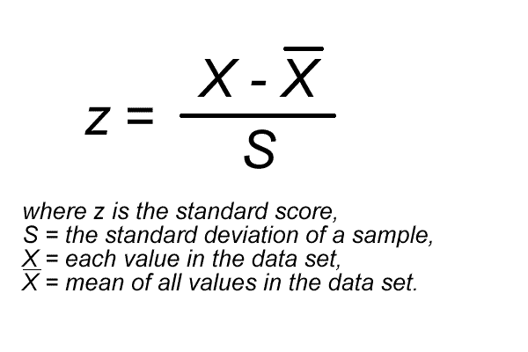
Standardized Values (Z-scores)
In other words, it measures how many standard deviations an observation falls from the mean.
Observations larger than the mean have positive z-scores whereas negative z-scores correspond
to an observation less than the mean.

Slide 5
Why Z-Scores are Important?
Z-scores tell us about percentiles (i.e. the percent of people that fall at or below that value). The percent of people that fall at or a below a particular z-score depends on the SHAPE of the distribution. (We can standardize these with a standard normal distribution, which we will learn more about Monday).
They allow you to standardize scores (for example comparing the ACT versus the SAT).

Slide 6
Test Distribution So Far
Mean: 85.5
Standard Deviation: 10.56
Median 87.5
Q1: 79
Q3: 91

Slide 7
So How Well Did I do?
It’s all relative: The mean is 80 and the standard deviation is 6.07. What if you scored
An 86? What would your z-score be?
If you scored an 80, what percentile would you be in? NOTE: percentiles are often
defined as the percent of people who scored BELOW a certain value).

Slide 8
HW 14/Classwork
Complete Exercises 2.1, 2.2, 2.3, 2.4, 2.5 (a-c), 2.8

Slide 9
First Problems

