Slide 1
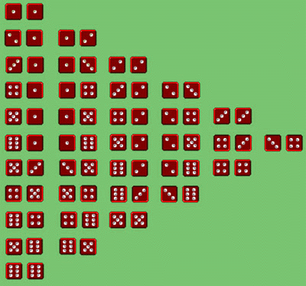
AP STATS: Young Money Casino
Choose one person at your table to be the casino owner (the first person to arrive at your table).
Everyone gets 5 chips (all worth the same). Your casino owner will give you your 5 chips and will “run the casino game” meaning they will collect the chips and do the payout as well.
Here are the rules of the game.
1.) It costs 1 chip to play (which is worth $1).
2.) Roll the dice.
3.) If the two dice dice sum to 6, 7, or 8 you win double your chips (i.e. you win a chip plus you get your chip back) paid out by the dealer. If it the sum is anything else, you lose your chip (which the dealer collects).
4.) Play 10 rounds of the game.
At the end of 10 rounds have players count how many chips they won or lost. Did the casino gain money or did the players gain money as a whole?
What is the EXPECTED VALUE of a 1 chip bet?

Slide 2
Insurance Works the Same Way
Insurance companies determine everything based on expected value.
Consider an auto insurance company. Based on past experience they have approximated the following probabilities for the amount of money their policy holders will file in claims in any given month. What should the company charge its policy holders per month?
X | $500 | $1000 | $3,000 | $15,000
P(x) | 0.03 | 0.02 | 0.01 | 0.001

Slide 3
Video of the Day
The Gambler’s Fallacy:
http://www.youtube.com/watch?v=K8SkCh-n4rw

Slide 4
The Hot Hand and The Gambler’s Fallacy
Ironically, the gambler's and hot hand fallacies can lead to contrary expectations about what will happen next: Suppose that someone bets on a "lucky" number, and wins several times in a row. The gambler's fallacy predicts that the lucky number will be less likely than chance to come up on the next bet, but the hot hand fallacy predicts that the lucky number is more likely to come up. This means that both predictions cannot be true, despite the fact that many gamblers probably have committed both fallacies, even on the same day, though not at the same time. So, these two forms of argument cannot both be cogent, and in fact both are uncogent.

Slide 5
Rules for Means
Means of random variables (X) behave like averages of one variable data
Example: Crickets in a field have a mean length of 1.2 inches. What is the mean
In centimeters? 2.54*μ_{x}

Slide 7
Variances
X AND Y must be independent which is oftentimes assumed in probability models. However,
you should always ask yourself if the events are independent.

Slide 8
Example: Lotto
The payoff (and only the payoff) X of a $1 ticket in the Tri State pick 3 game is $500 with a probability 1/1000 and $0 the rest of the time. Here is the combined calculation of the mean and variance.
What if we had bought two tickets? On separate days
(meaning the events are independent)?

Slide 10
What about random variables that are normally distributed?
A linear combination of independent Normal random variables IS ALSO NORMALLY DISTRIBUTED.
For example: If X and Y are independent normal random variables and a and b are fixed numbers, then aX + bY and X + Y or X-Y is ALSO NORMALLY DISTRIBUTED.
We can simply use the rules for means and variances in these cases.
Important note: We can’t simply add standard deviations. We must add variances and take the square root.

Slide 11
Example: Combining Random Variables.
Brendan and Tim are playing in an MB golf tournament. Their scores vary as they play the course repeatedly. Tim’s score X has the N(110, 10) distribution. Brendan’s score Y varies from round to round according to the N(100, 8) distribution.
If they play independently, what is the probability that Tim will score lower than Brendan and thus do better in the tournament?

Slide 12

Let’s TRY!

Slide 13
Let’s TRY!

Slide 14
HW #39
Read the end of Section 7.2 and the summary (You might prefer to read the AP lesson I posted last night instead- it is a great summary.
Complete the following problems from the AP Questions
FR: #4, 6,
MC: #3, 8,
We will be completing the rest during class tomorrow to review.
Optional: Complete some review exercises
#7.55, 7.56, 7.60, 7.61

