Slide 1
Honors Precalculus: Do Now
Work QUIETLY in pairs to graph the following rational function by hand. Be sure to complete the FAITS.

Slide 2
Agenda
Today: Polynomial Applications
Tuesday – Review Game
Wednesday– Chapter Test – Chapter 3

Slide 3
Video of the Day
Parents ate all the CANDY!

Slide 4
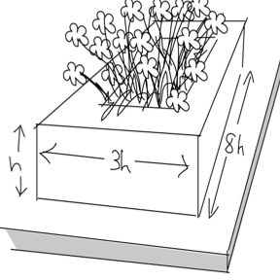
Example 1: Polynomial Modeling Problems (expect to see one!)
You are designing a stone planter for a city park. You want the length of the planter to be eight times its height, and the width to be three times the height. The sides need to be 1 foot thick to act as a bench. It does not need a bottom, and will be filled with soil. Calculate the outer dimensions of the planter if it is to hold 90 cubic feet of soil.

Slide 5
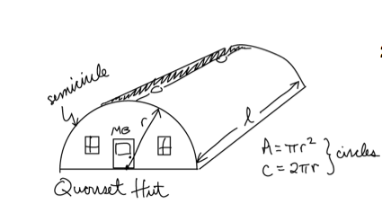
Problem 2
A Quonset hut is a building shaped like half a cylinder. It's an easy structure to build for temporary housing. Let's say you have 1000 sq. ft. of material to build a Quonset hut. Find the maximum volume of such a hut with a surface area of 1000 sq. ft. Ignore the windows and doors.

Slide 6
Classwork
Work in groups on the polynomial applications problems. These are difficult problems. Take your time and NO WHINING!!
The answers will be posted online this evening.
I will also post the Review HW to review for the Chapter 3 Test.

Slide 7
HW 23: Review for the Chapter 3 Test
Ch. 3: Review Exercises (pg. 292-294)
#3, 5, 8, 16, 21, 28, 30, 31, 37, 44, 51, 53, 58, 63, 77, 81
CHOOSE 10. I would choose one’s that you struggle with. Not one’s that are easier… (it’s a review for a test after all).

