Slide 1
Honors Precalculus: Do Now
1.) Find the first 3 partial sums and the nth partial sum of the sequence a_{n}.
2.) Find the sum
3.) Write the sum in sigma notation.
2 + 4 + 6 + 8 + … + 20

Slide 2
Idea of the Day!
Google Earth Time Lapse Video

Slide 3
Arithmetic Sequence
Start with a number a and add a fixed constant d to it.
To find the nth term in an arithmetic sequence.
a_{n}=a + (n – 1)d

Slide 4
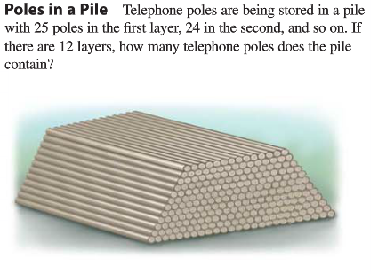
Problem….

Slide 5
Example 1:
Find the first 6 terms and the 300th term of the arithmetic sequence.
13, 7, …

Slide 6
Example 2: Partial Sums of Arithmetic Series
Suppose we want to find the sum of the numbers 1, 2, 3, 4, …, 100.

Slide 7
Example 3: Finding the Partial Sum of an Arithmetic Sequence
Find the sum of the first 40 terms of the sequence:
3, 7, 11, 15,….

Slide 8
You Try!
Find the sum of the first 50 terms of the arithmetic sequence
3, 10, 17, 24,…
Find the sum of the first 50 odd numbers.

Slide 9
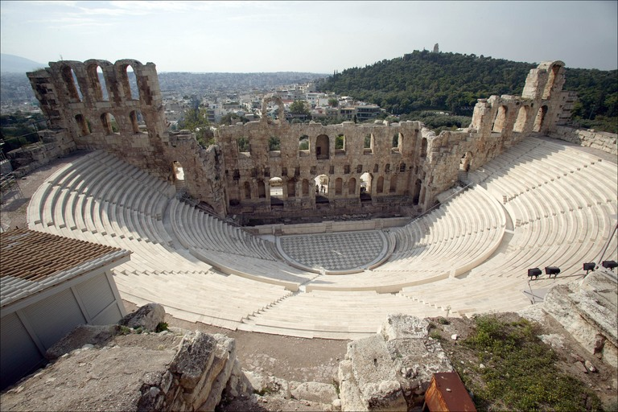
Example 4: Amphitheater Seats
An amphitheater has 50 rows of seats with 30 seats in the first row, 34 in the second, 38 in the third and so on. Find the total number of seats.

Slide 10
YOU TRY!
1.)
2.)

Slide 11
HW #46: Arithmetic Series
Part 1: Section 12.2 #19, (23), 25, 61, 64 The bolded ones are mandatory!
Part 2: Watch the video and take notes on geometric series! (15 minutes)- “Flipped Classroom”

