Slide 1
Honors Precalculus: DO NOW
Graph the following polar equations with your graphing calculator. See if you can name the shape.
1.) r = 2 + 5sin θ
2.) r = 4 cos (5θ)
3.) r = 2 sin (6θ)
3.) r² = 4sin (2θ)

Slide 2
Fact of the Day!
In the average lifetime, a person will walk the equivalent of 5 times around the equator.
Minus 40 degrees Celsius is exactly the same as minus 40 degrees Fahrenheit

Slide 3
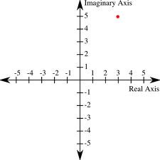
Reminder: Graphing Complex Numbers
Graph z₁ = 2 + 3i
Graph z₂ = 3- 2i
Graph z₁+z₂
Graph 2z₁
Graph –z₁
Graph z₁*z₂

Slide 4
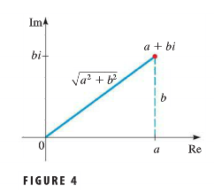

Slide 7
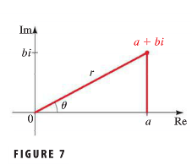

Slide 9
Multiplying/Dividing Complex Numbers

Slide 11
HW 29: The Complex Plane
8.3 (pg. 562-563) #5, 9, 15, 17, 29, 31, 55, 61

