Slide 1
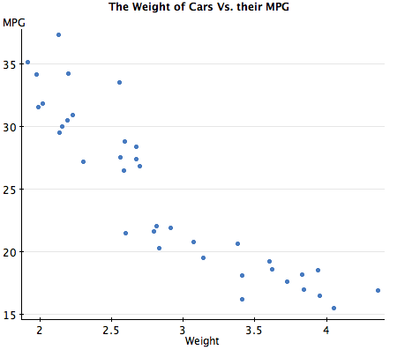
AP STATS: DO NOW
Below is a scatter plot showing the weight of a car versus the car’s MPG’s.
a.) What is the response variable and explanatory variable?
b.) Describe the form, direction and strength of the correlation?

Slide 2
Agenda:
Short quiz on 3.1 tomorrow (50 points).We will most likely go into the computer lab to work with Minitab after the quiz. Focus on the big picture ideas for the quiz.

Slide 3
Video of the Day

Slide 4
Measuring Linear Association: Correlation
Our eyes are NOT good judges of how strong a linear relation is.
Correlation (r): measures the numerical strength and direction of a linear relationship between 2 quantitative variables.

Slide 5
How r is calculated?
The sum of the z-scores for each variable multiplied together divided by n-1.

Slide 7
Some facts about r, Correlation
1.) Correlation makes no distinction between explanatory and response variable.
2.) r does not change when change the unit of measurement.
3.) Positive r means a positive association and negative r means a negative association.
4.) r is always between -1 and 1 and measures the strength of the relationship.
5.) r is not RESISTANT (i.e. it is impacted by outliers).
IMPORTANT NOTES: both variables must be quantitative. Correlation (r) only measures the strength of a linear relationship (not curved). Correlation is a not a complete summary of two variable data (give numerical summaries too! Always plot the data too).

Slide 8
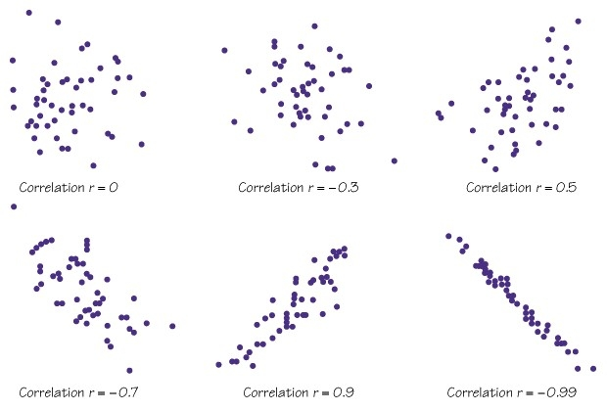
How correlation measure the strength?

Slide 9
HW to review for the quiz.
Read the section 3.1 summary
Complete 3.21 OR 3.22, 3.25, 3.26, 3.27

