Slide 1
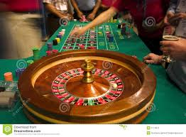
Honors Precalculus: Do Now
1.) You are betting with your friend. Every time you flip heads, your friend pays you a dollar. Every time you flip tails, you pay your friend a dollar. If you play 100 times how much money would you expect to win or lose.
2.) Now let’s play roulette. You have $1000 and you bet 1 dollar every round and play 1000 times. You bet $1 on black every time. How much of your 1000 dollars would you expect to walk away with (on average) after 1000 rounds.

Slide 2
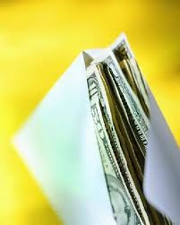
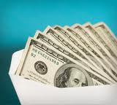
Problem of the day!
There are two envelopes, one you know has $1000 in it, the other has either $2000 or $500, but you don’t know which? Which envelope do you choose?

Slide 3
Problem of the Day
What if you played this game 10,000 times. Now what would your strategy be.

Slide 4
Expected Value
The summation of the outcomes multiplied by the probability of each outcome
Note: Expected value can be positive or negative.
Expected value of zero implies a “fair” game.

Slide 5
Simple Example
Consider this simple example. You play a game where heads means you win $2 and tails means you lose 1 dollar. What is the expected value of the game.

Slide 6
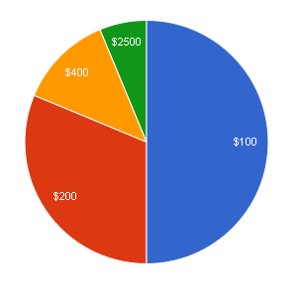
Spinner Problem
What bet would you take if you could only pick one color and we spun the spinner
Everyday for the rest of the year.
How much money should it cost to play the game?

Slide 7
Expected Value
Imagine you have a stack of cards 10 cards numbered 1-10. What is the expected value when you pick a card at random?

Slide 8
Should you play.
Let’s play a game. It only costs 1 dollar to play.
1 (0.25), 0 (0.25), 1(0.125) 2(0.25), 3 (0.125)
$1
$1
$3
$0
$2

Slide 10
Economics Example
My dad, who is an economist and studies game theory, recently looked at how hedge funds can mask true gains. I will give you the article to read over break.
Here are the basics:
Hedge funds typically charge a 2% management fee plus a 20% performance fee for profits over a certain benchmark.

Slide 11
Whiteboards
Consider the spinner below. It costs $50 to play (which you lose no matter what).
What is the expected value?

Slide 12
Whiteboards
You buy a raffle ticket for $5 and have a chance to win 3 items (a VW GTI valued at $32,000, a 42” HDTV valued at $1000, and an IPAD retina display valued at $500.)
If 10,000 tickets were sold, what is the expected value of a raffle ticket.

Slide 13
Whiteboards

Slide 14
Whiteboards
You roll a die. What is the expected value?

Slide 15
Whiteboards
You are playing roulette and bet $50 on red and $20 on 12. What is your expected value?

Slide 16
HW #29: Expected Value
Section 14.4 (pg. 920-921) #4, 5, 13, 14, 15, 21, 25
Read Hedge Fund Wizards

