Slide 1
Honors Precalculus: Do Now
1.) A Statistics class is interested in looking at the average time it takes MB students to get to school each day. The researchers use a Simple Random Sample of 25 MB students for the number of minutes it took each student to get to school. The data is below. Determine the mean, std. deviation and construct a 95% confidence interval for the mean time (μ) it takes students to get to school. HINT: use the t-table as you will calculate the sample standard deviation.
15, 34, 62, 10, 41, 27, 22, 15, 10, 8, 12, 17, 21, 19, 31
2.) CNN is interested in determining the percent of voters that are going to vote for Obama in a district in Ohio so that they can call the results early. The pollster takes an SRS of 350 people and asks who they voted for after exiting polls and found that 212 said that they had voted for Obama. Construct a 95% confidence interval for the true percent of voters in this county that voted for Obama.

Slide 2
Project coming up.
I will be handing out our second project (maybe by the end of the week, but more likely on Monday) that will be due a week before Christmas Break.
It will involve data collection and analysis on Statistics. Computing the standard deviation, mean, confidence intervals and hypothesis testing.
The project will be a group project and will most likely be done in groups of 2-3.
This is a great introduction to what you might end up doing in college to write a thesis depending on the field that you enter. Oftentimes a thesis involves generating new and unique theories and using statistics to prove/disprove your theory.

Slide 3
Test Coming Up: After Thanksgiving
Bayesian Statistics
Discrete Probability
Expected Value
Permutations/Combinations
The Normal Distribution
Using the Z-Table
Confidence Intervals
Hypothesis Testing

Slide 4
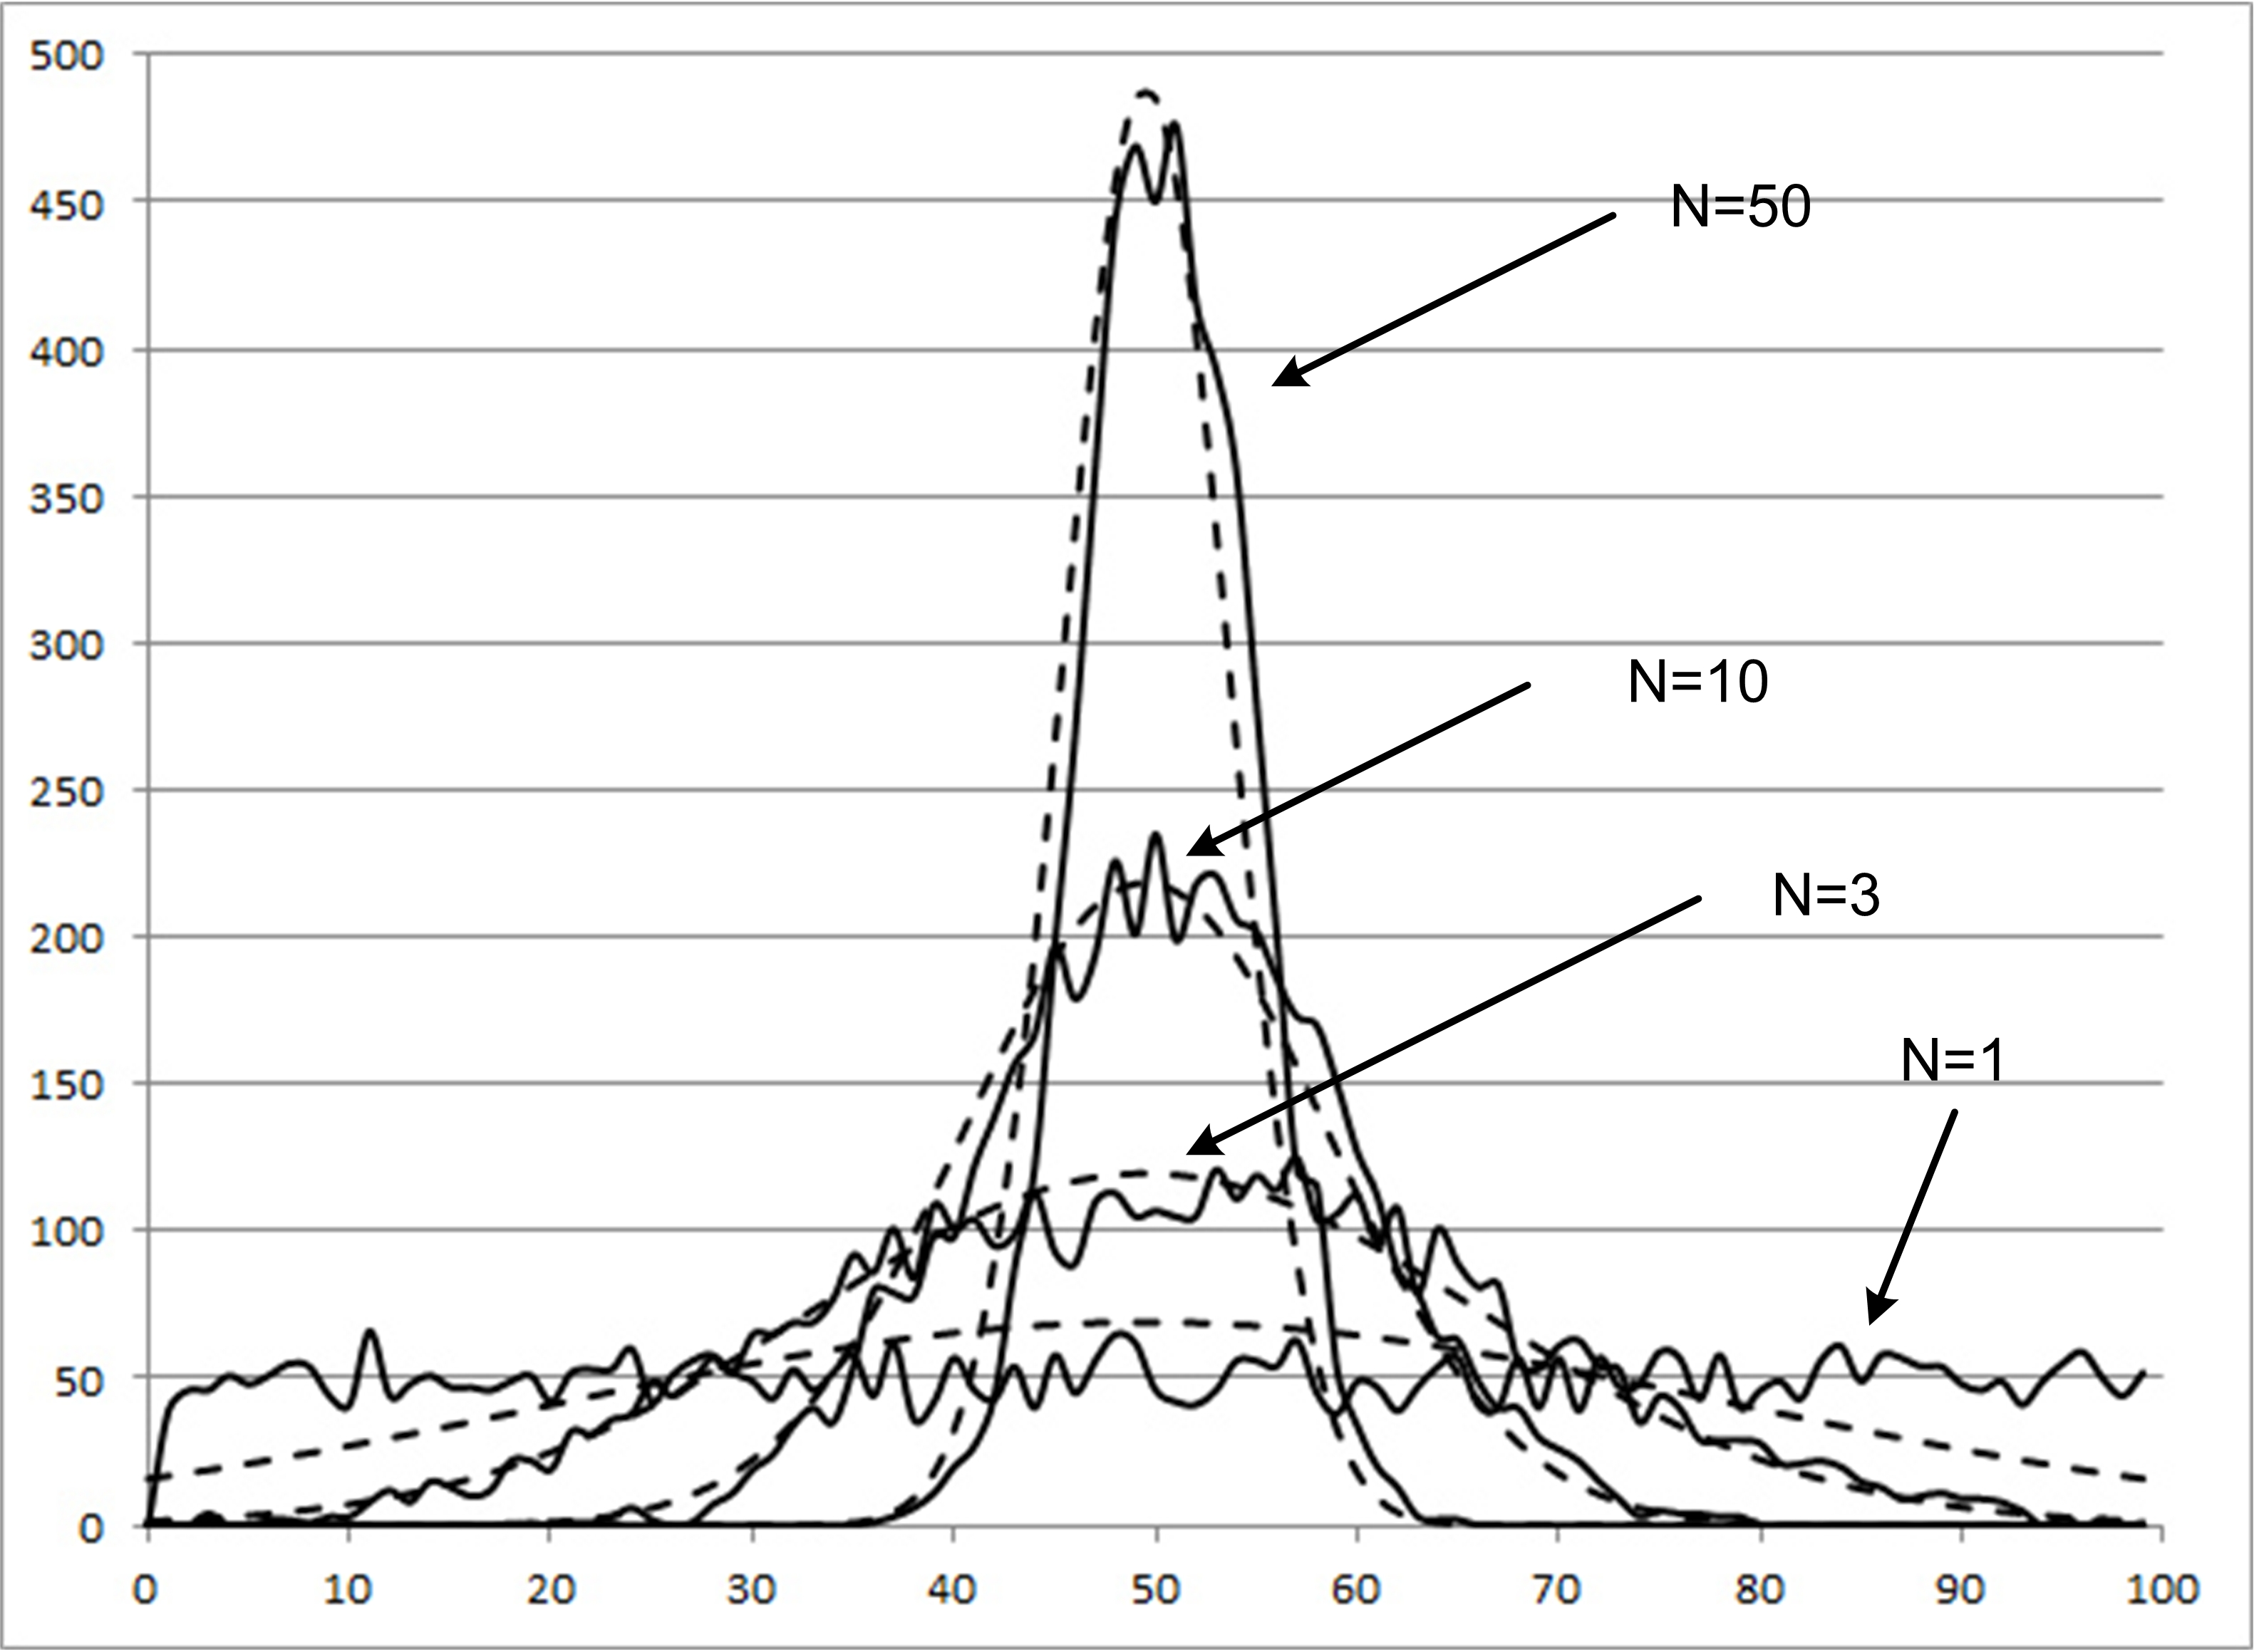
A bit more about why we use the normal distribution.
Central Limit Theorem: says that when you put together a lot of random events (and take the average of these samples), the aggregate will tend to follow a bell-curve.

Slide 5
Hypothesis Testing
This is the one of the most important ideas in statistics as it allows us to prove beyond reasonable doubt that something is in fact happening and it is not caused by CHANCE.
In most fields 95% confidence or a α = 0.05 is used as an acceptable measure of certainty.
INNOCENT UNTIL PROVEN GUILTY!

Slide 6
Hypothesis Testing
Formula for proportions:
Null Hypothesis:
Alternate Hypothesis:

Slide 7
Example 1:
A team of eye surgeons has developed a new technique for a risky eye operation to restore the sight of people blinded from a certain disease. Under the old method, it is known that only 30% of patients who undergo this operation recover their eyesight.
Suppose that surgeons in various hospitals have performed a total of 225 operations using the new method and that 88 have been successful (the patients fully recovered their sight). Can we justify the claim that the new method is better than the old one (use a 5% level of significance)

Slide 8
EXAMPLE 2:
How can you prove that you are clairvoyant?
CARD GAME EXAMPLE: Can you predict the suit of cards in a deck.

Slide 9
Example 3: Building Code
A building inspector believes that the percentage of new constructions with serious code violations is may be even greater than previously claimed (7%). She conducts a hypothesis test on 200 new homes and finds 23 with serious code violations. Is this strong evidence against the 0.07 claim?

Slide 10
HOMEWORK
Complete the following homework. Note that there are a mixture of problems dealing with confidence intervals and hypothesis testing.

