Slide 1
Honors Precalc: Do Now
Have one partner count the number of blue M&M’s in your bag. Have another count the number of orange M&M’s in your bag. Determine the PERCENT of blue and orange M&M’s in your bag.
Create a 95% confidence interval for the true percent of blue M&M’s and orange M&M’s of all the M&M’s in the world! Split up the work!!

Slide 2
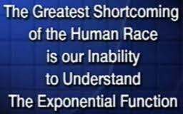
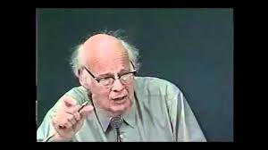
Video of the Day!

Slide 3
Video Translation
You have just found out that the population of Chipotle stores are growing at a rate of approximately 5% per year. How long will it take the number of stores to double?

Slide 4
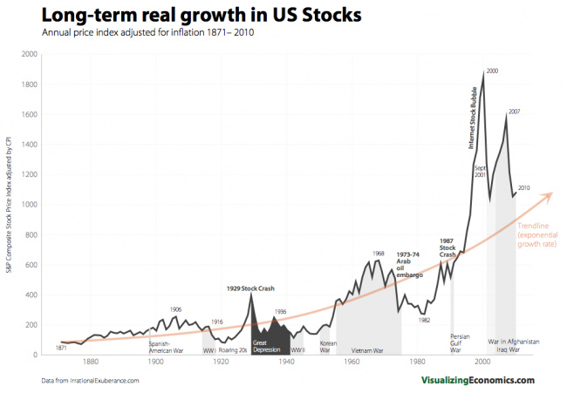
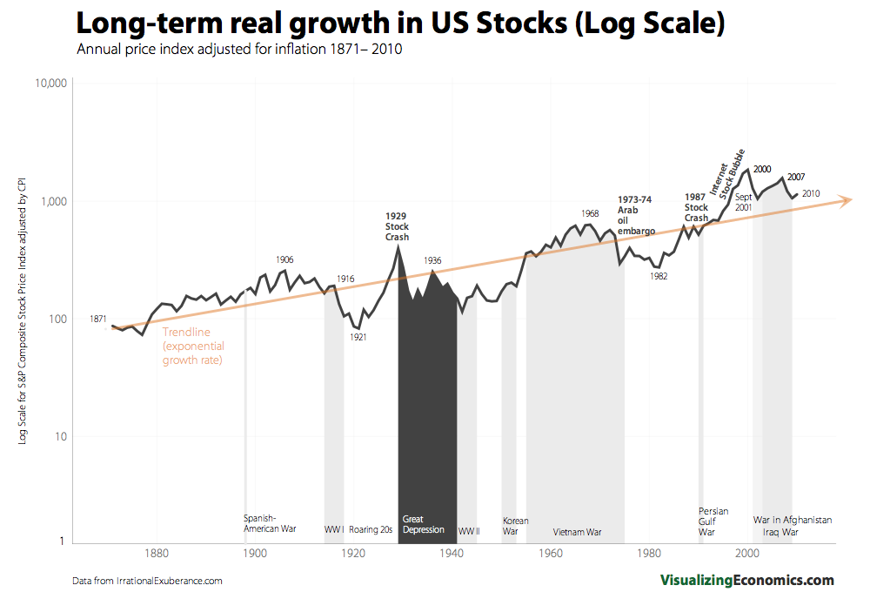
Stock Example
The stock market has grown 10% per year (including dividend yield)
on average over the last 100 years or so. What is it’s doubling time (on average)?

Slide 5
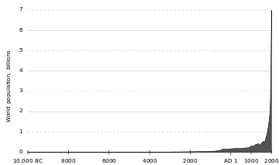
World Population Growth
The world population grew from 1 billion to 7 billion from 1800 to 2011

Slide 6
Statistics Project
Your project, due December 20th (emailed and submitted as a hard copy) will be to use some of the statistics that you learned throughout this unit to come up with a survey and create graphs and confidence intervals about relevant topics to you at Moses Brown.
Option 2 is to design an experiment (like the techno vs. Mozart study) and conduct a 2 sample t-test. Try to stick to 2 groups if you do this.
You may work with anyone from any of my 3 honors precalc classes (groups of 2-4).

Slide 7
Exponential and Logarithmic Functions
Exponential Function: f(x) = a^{x} where a>0 and a≠1
F(x) = 2^{x} or G(x) = 1.05^{x} H(x) = 0.93^{x}
Exponential functions are particularly useful for population growth, money growth/decay, inflation, technological expansion and the spread of new ideas.
Exponential Growth occurs anytime that something is growing at a fixed RATE (as opposed to a fix quantity – which is linear).

Slide 8
Growth of an Investment
Say that I have $1,000 that I invest in the stock market. I use the 10% annual growth rate to approximate how much my money will be worth in 17 years.

Slide 9
Evaluating Exponential Functions
Evaluate the following exponential function for the given values.
Let f(x) = 3^{x}
a.) f(2) b.) f(π)
c.) f( ) d.) f(√2)

Slide 10
Graphs of Exponential Functions
Sketch the graph of each exponential function by making a table.
F(x) = 3^{x} F(x) = (1/3)^{x}

Slide 11
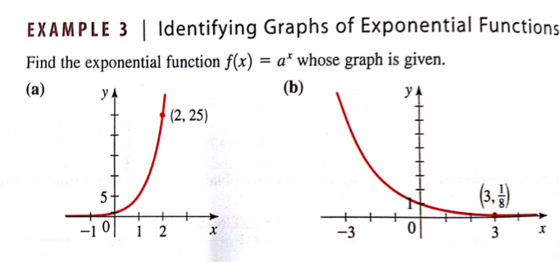
Identifying the Graphs of Exponential Functions.
.

Slide 12
Transformations
Use the graph of f(x) = 2^{x} to sketch the graph of each function.
g(x) = 1 + 2^{x} b.) h(x) = -2^{x} c.) 2^{x-1}

Slide 13
Compound Interest
A Sum of a $1000 is invested at a rate of 12% per year. Find the amounts in the account after
3 years if interest is compounded annually, semiannually, quarterly, monthly, and daily.

Slide 14
Homework #33
4.1 Exercises.
Page 307-308 #2, 5, 9, 11, 16, 19, 21, 27, 28, 47, 52

