Slide 1
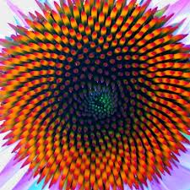
Honors Precalc: Welcome Back from Break!
Collect your HW Journal, which has your test inside. Look over your Unit Test on Exponential and Logarithmic Functions.
If you did any winter break extra credit please hand it in now.
Write a formula for the sequence below. Find the 100th term in the sequence.
5, 10, 15, 20, 25, 30

Slide 2
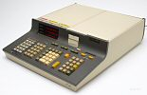
Fun Facts of the Day! Video of the Day to Follow
A lifespan is a billion heartbeats.
Remarkably, there exist simple scaling laws relating animal metabolism to body mass. Larger animals live longer; but they also metabolize slower, as manifested in slower heart rates. These effects cancel out, so that animals from shrews to blue whales have lifespans with just about equal number of heartbeats — about one and a half billion, if you simply must be precise. In that very real sense, all animal species experience “the same amount of time.”
To start Apple Computer in 1976, Steve Jobs and Steve Wozniak each sold their most prized possessions:
Jobs sold his Volkwagen Bus and Wozniak sold his HP scientific calculator -- each was worth $500.
AGENDA:
-Final Unit: Sequences and Series
-Tuesday Jan 14 (a mini test or quiz on sequences and series.)
-Wed, Thursday and Friday will be review days for the exam.
-Semester Exam will be Friday Jan 24th.

Slide 3
Sequences and Series
A sequence is an infinite list of numbers.
The domain of a sequence is the natural numbers.
Terms of a sequence:

Slide 4
Example 1: Finding the Terms of a Sequence
Find the first five terms and the 100th term of the sequence defined by the formula.
a.) a_{n}=2n -1
b.) c_{n}=n² -1
c.) t_{n}=
d.) r_{n} =

Slide 5
Graphing Calc.
Put your calculator in sequence mode

Slide 6
Example 2: Finding the nth Term
Find the nth term of the sequence below.
a.)
b.) -2, 4, -8, 16, -32

Slide 7
Recursively Defined Sequence
If the nth term may depend on some or all of the terms preceding it.

Slide 8
Example 3: Finding the nth Term
Find the first 5 terms of the sequence defined recursively by a₁=1 and
a_{n}=3(a_{n-1} + 2)

Slide 9
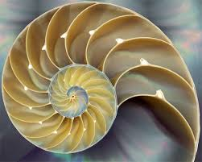
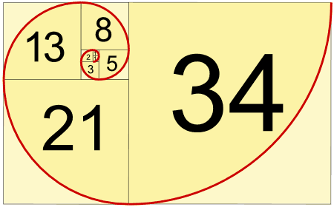
Example 4: The Fibonacci Sequence
Find the first 11 terms of the sequence defined recursively by F₁=1, F₂=1 and
F_{n} = F_{n - 1} + F_{n - 2}

Slide 11
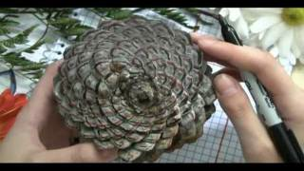
Video of the Day

Slide 12
HW #44
Part 1: Section 12.1 (pg. 792-793): #3, 7, 9, 11, 13, 17, 25, 26, 29, 30

