Slide 1
Honors Precalc
Do Now!! In your Group of 4. Solve the problem and put your answer on the board.
1.) Eastside Pockets (which currently has 1 store) has decided to expand its model to have multiple stores throughout Rhode Island and Massachusetts. They plan to expand at a rate of 18% per year. How many stores could we expect them to have after 5 years, 10 years , and 50 years.
2.) a.) Find the amount after 12 years if $2500 is invested at an interest rate of 3% per year, compounded continuously.
A(t) = Pe^{rt}
b.) What is the APY (annual percentage yield)- i.e. the equivalent simple interest on a one year investment?
3.) Approximate e (to at least 3 decimals correct) using both the formulas that we learned yesterday. Show your work!
4.) You buy a car for $26,000. The car is depreciating at a rate of 11% per year. Write a function for the value of the car after t years? How much will it be worth in 1, 5, and 10 years?

Slide 2

Deriving Pert from Compound Interest!

Slide 3

Quote of the Day!

Slide 4

Photo of the Day

Slide 5
Statistics Project
Your project, due December 20th (emailed and submitted as a hard copy) will be to use some of the statistics that you learned throughout this unit to come up with a survey and create graphs and confidence intervals about relevant topics to you at Moses Brown.
Option 2 is to design an experiment (like the techno vs. Mozart study) and conduct a 2 sample t-test. Try to stick to 2 groups if you do this.
You may work with anyone from any of my 3 honors precalc classes (groups of 2-4).

Slide 6
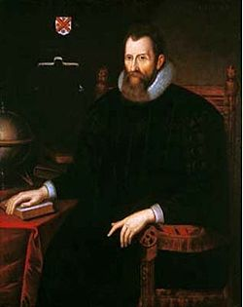
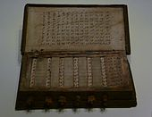
Logarithmic Functions
Why study logarithms? Thermodynamics, sound and light perception, pH, Richter Scale.
John Napier invented logs and used
them to make calculations easier

Slide 7
Logarithmic Functions
Logarithms are just exponents!!!!
All exponential functions are one to one (pass the horizontal and vertical line test) and therefore have an inverse.
Logarithms are the inverse function for exponential functions.
For example take y = 2^{x}
What would the inverse be?

Slide 8
Log Form to Exponential Form
Log Form: Exponential Form:
Log_{a}x= y
The Common Logarithm has a base of 10
Log₁₀x = log x

Slide 9
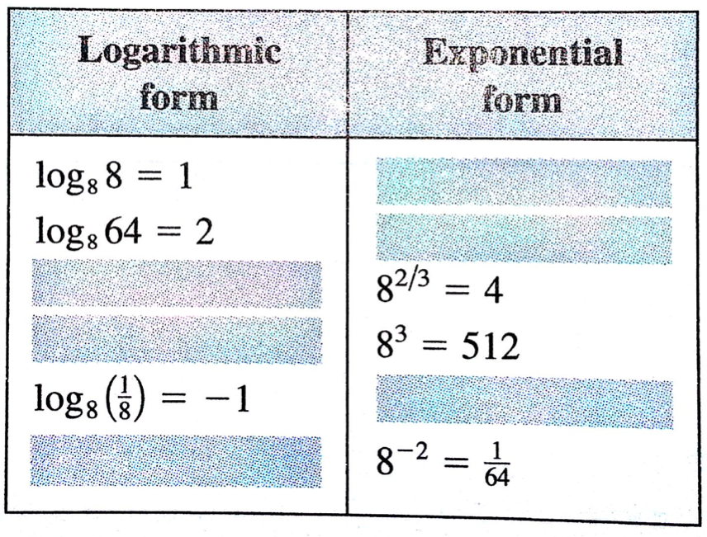
Converting Between Forms

Slide 10
Properties of Logs

Slide 11
Graphing a Log Function
Sketch the graph of f(x) = log₂x
y=log _{a} x, where a>0, a≠1, x>0, y∈R

Slide 12
Here’s what happens as you change the base!

Slide 13
Shifts and Transformations
Same as normal.
G(x) = - log₂x
H(x) = log₂(-x)
Q(x) = 2 + log₅ x
T(x) = log₁₀ (x - 3)

Slide 14
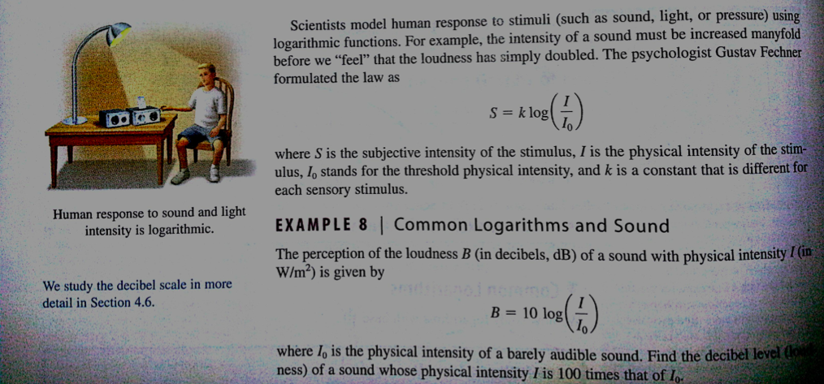
Word Problem

Slide 15
The Natural Logarithm
Ln x = log_{e}x
Ln x = y then e^{y} = x
What does ln e⁸ =________
Ln 5 = ________

Slide 16
HW #39
#6, 7, 8, 9, 13, 14, 17, 19, 20, 23, 41, 53, 55, 57

