Slide 1
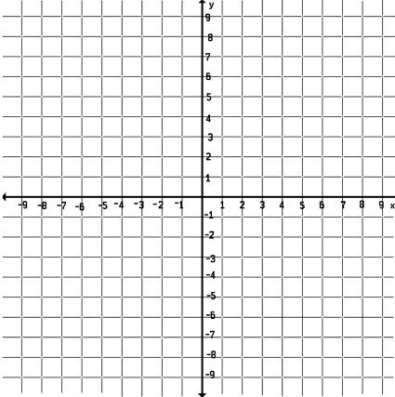
Precalculus Do Now
Sketch a graph of the polynomial function below by hand. Factor to find the roots. Make a table of test points (including the y-intercept). Then graph.
P(x) = 2x³ – x² - 18x + 9.
x | y

Slide 2
Homework Questions?

Slide 3
Quote of the Day!
“Si nous habitons un eclair, Il est le couer de l’eternel.”
Rene Char

Slide 4
Agenda!
Today: Writing the equation of a polynomial given a graph.
-Long/Synthetic Division of Polynomials
-Remainder and Factor Theorem
Wednesday: Real Zeros of polynomials
Thursday: Drop
Friday: Review section 3.1-3.4
Monday: No School – Columbus Day
Tuesday: Quiz on 3.1-3.4

Slide 5
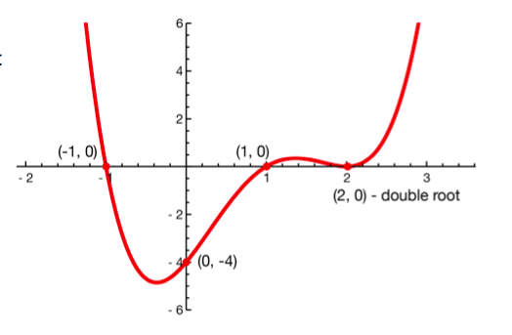
Example 1: Writing the Equation Given a Graph.
Write a polynomial of least degree given the graph.

Slide 6
Long Division of Polynomials
Dividing polynomials is similar to dividing numbers using long division.
Try 856/7 by long division to remind yourself how to do long division.

Slide 7
Example 1: Long Division
Divide 6x² -26x + 12 by x - 4

Slide 8
Example 2: Long Division
Divide 8x⁴ + 6x² – 3x + 1 by 2x² – x + 2

Slide 9
Example 3: Synthetic Division
Quick Method for dividing polynomials. It can only be used when the divisor is in the form x – c.
Use synthetic division to divide 2x³ – 7x² + 5 by x - 3

Slide 10
YOU TRY!
Use long division and synthetic division to make sure you are comfortable with both!
P(x) = 3x² + 5x – 4 divided by D(x) = x + 3

Slide 11
Another Use of Synthetic Division
Find P(-2) using the remainder theorem.

Slide 13
Brain Break/Snack Break

Slide 14
Whiteboards!

Slide 15
Homework #16
Section 3.3: Page 251-252 - #4, 6, 8, 20, 32, 41, 57, 65

