Slide 1
Warm-Up: Then Review Game

Slide 2
Stats Projects
Variables to measure for an experiment
Stress
Strength
Mental tests
Reaction time
If you are doing an experiment, make sure to get basic descriptive stats about your participants (age, grade, sex, etc.)

Slide 3
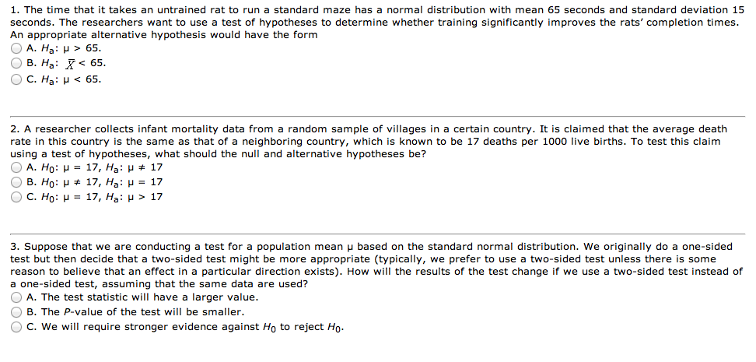

Slide 4
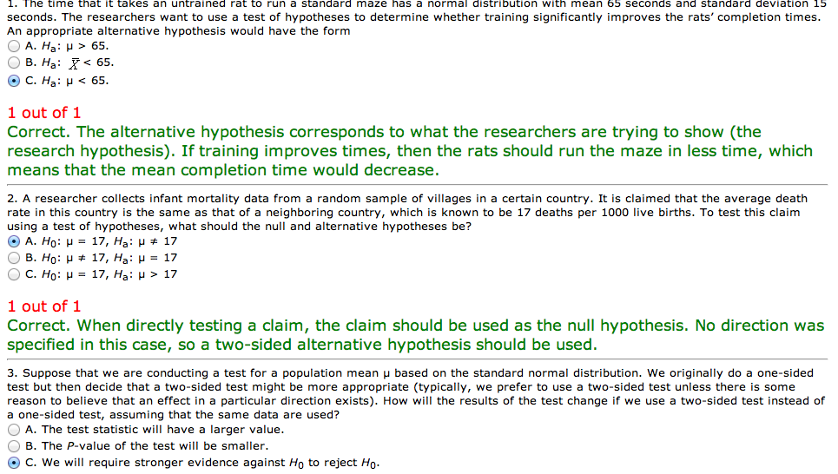

Slide 5
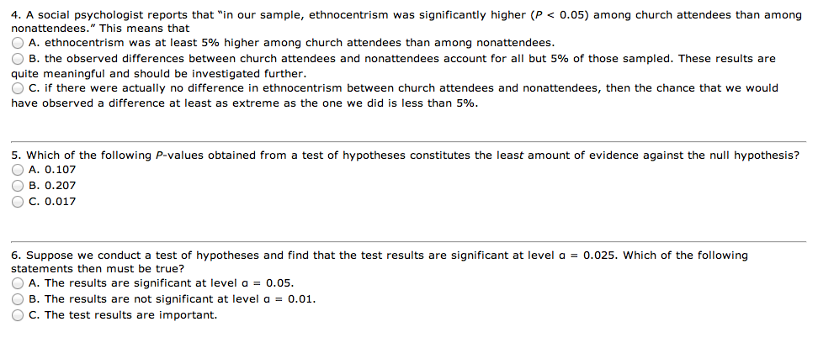

Slide 6
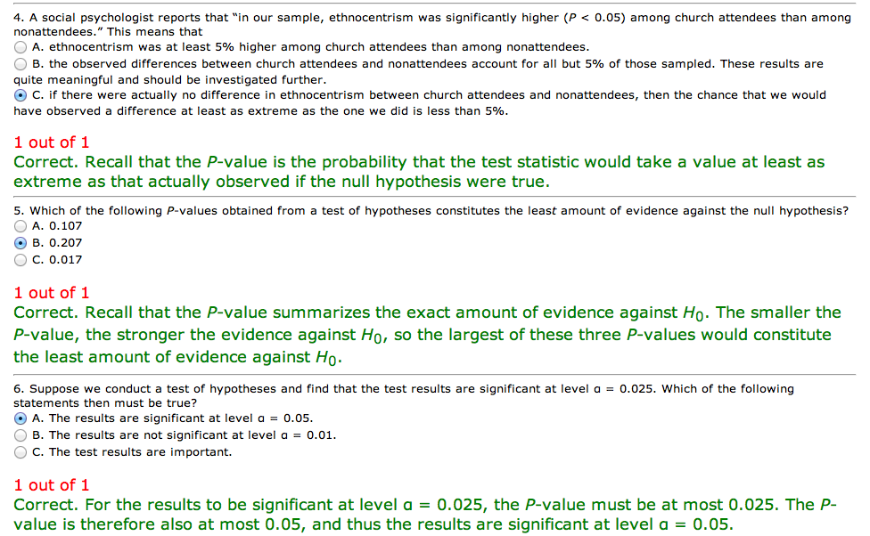

Slide 7
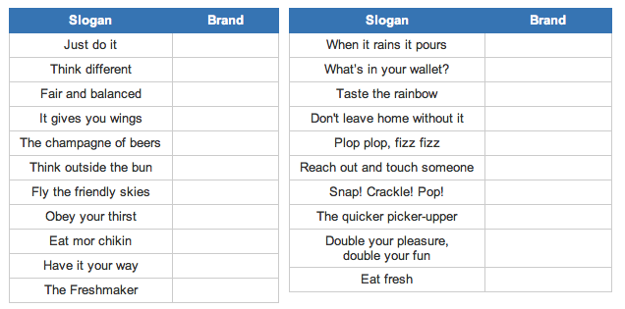

Slide 8
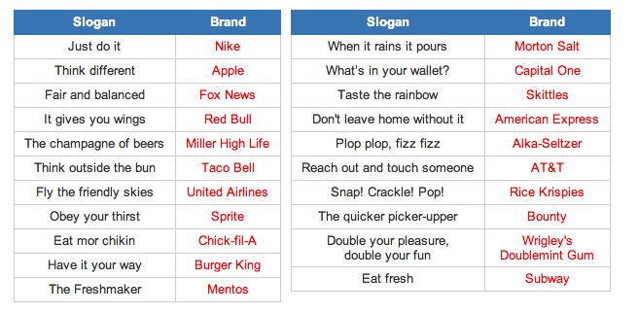

Slide 9


Slide 10
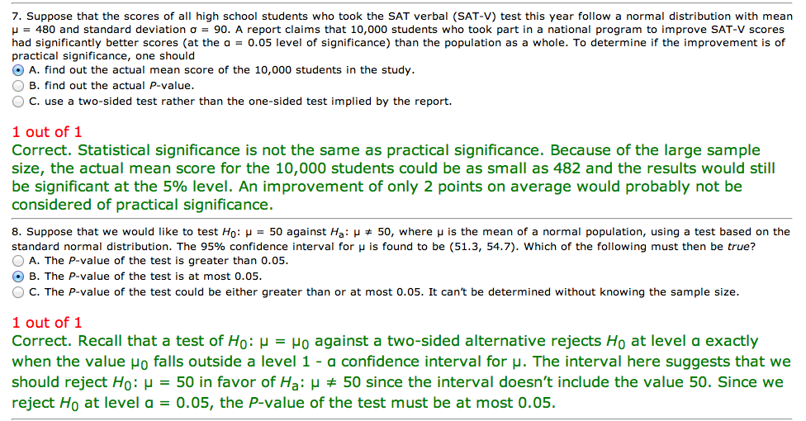

Slide 11
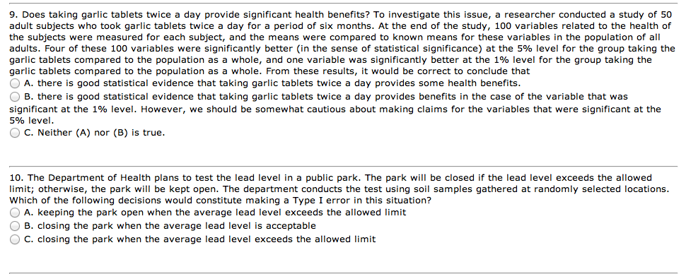

Slide 12
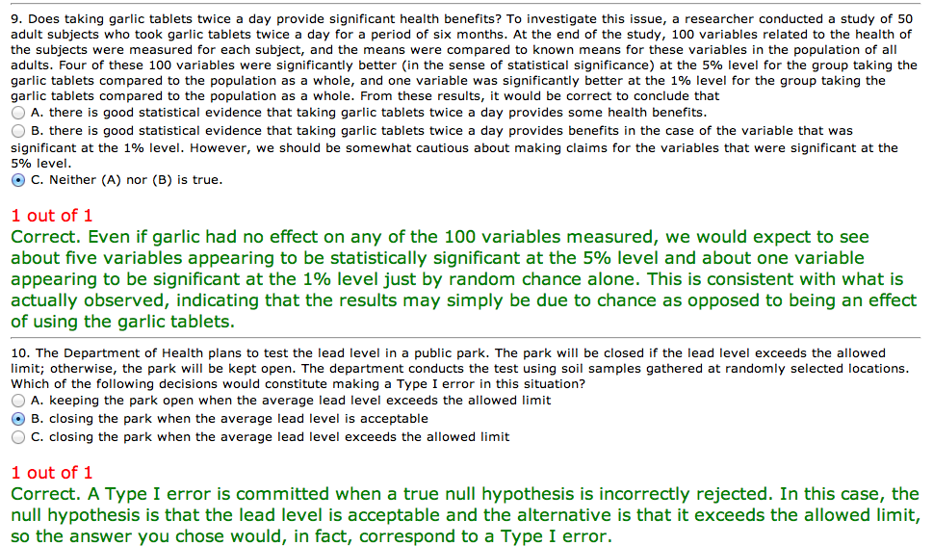

Slide 13


Slide 14
